Slide 1
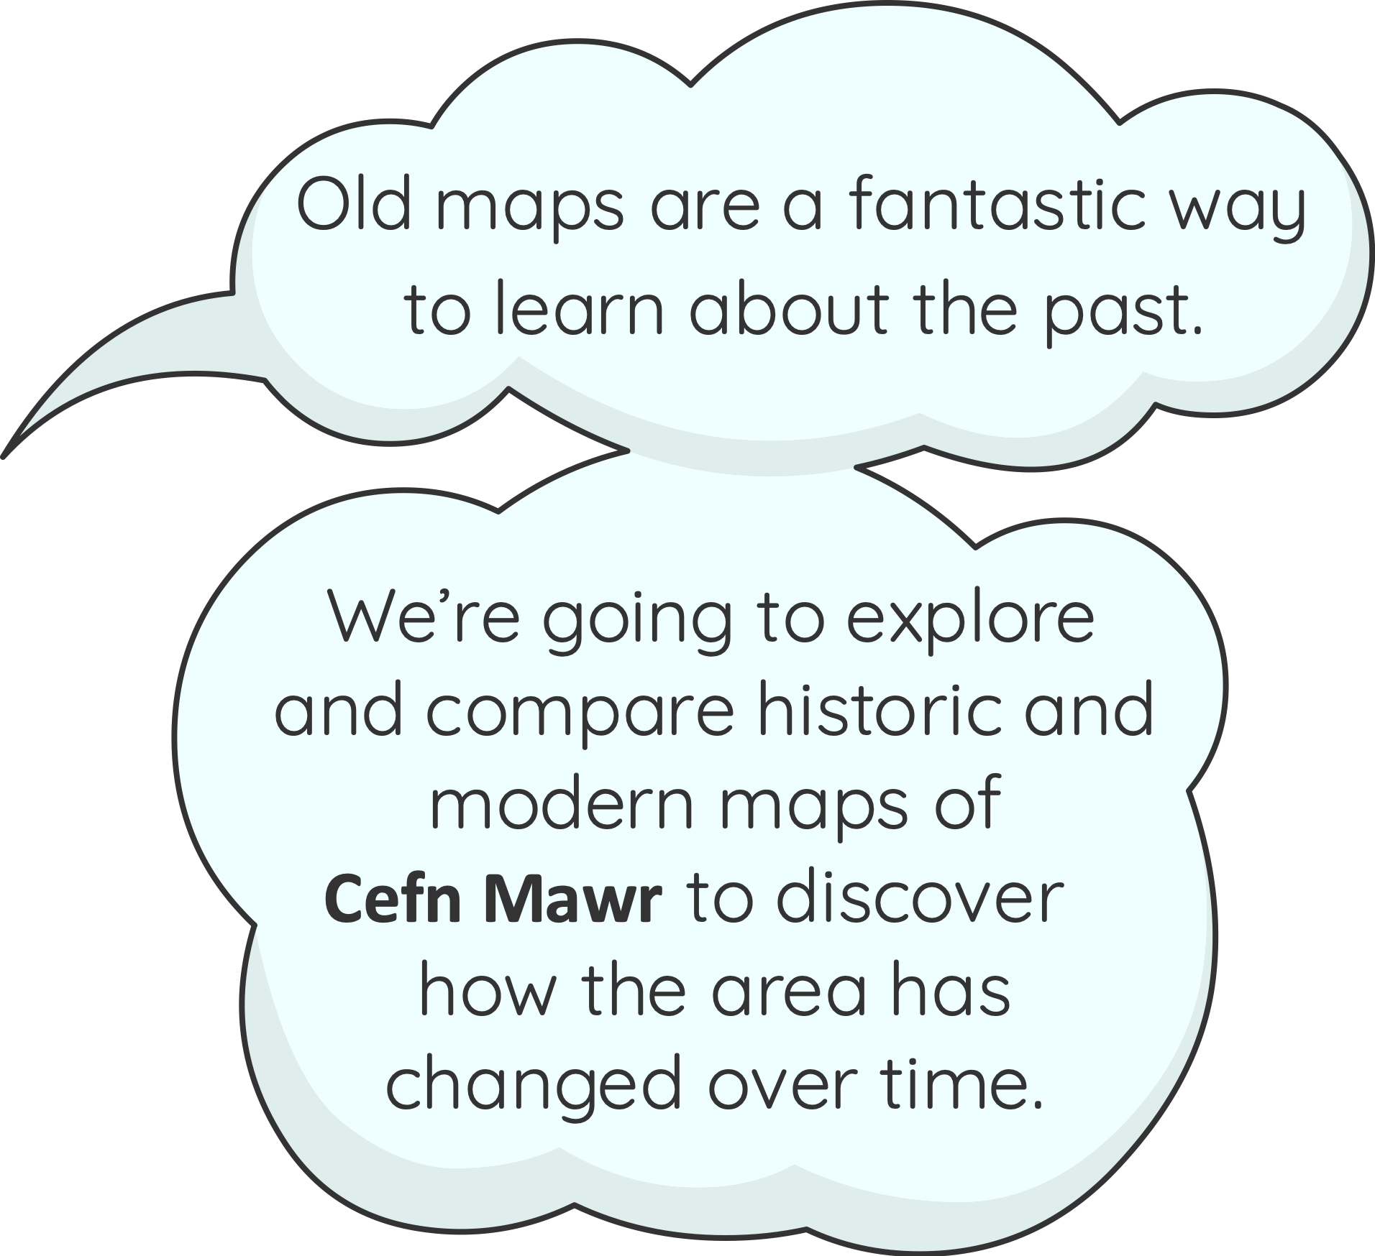

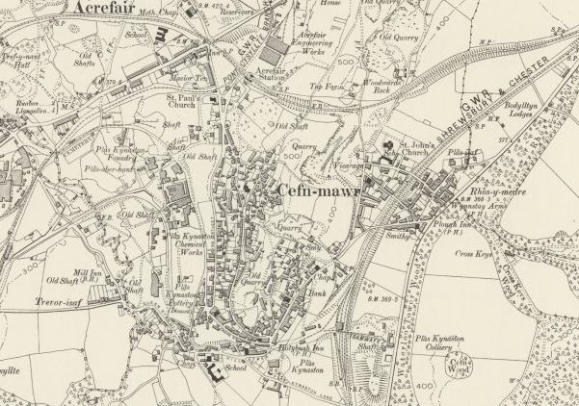
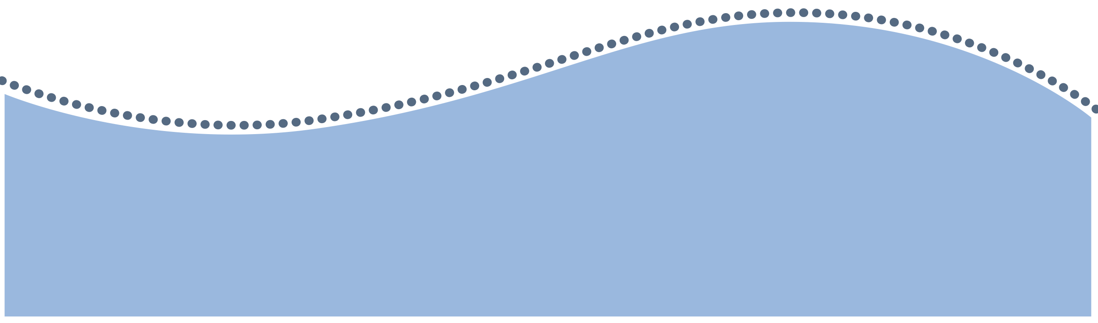
How has Cefn Mawr Changed Over Time?
www.pontcysyllte-aqueduct.co.uk

Slide 2

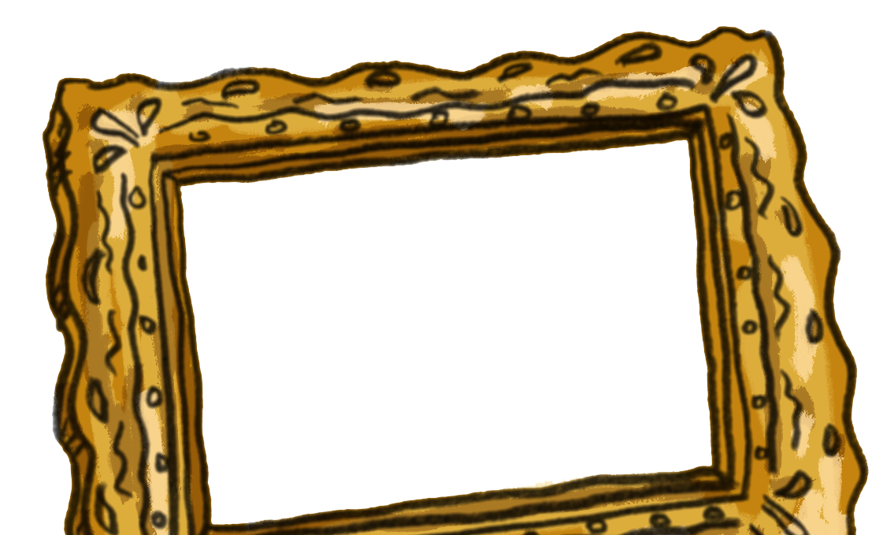

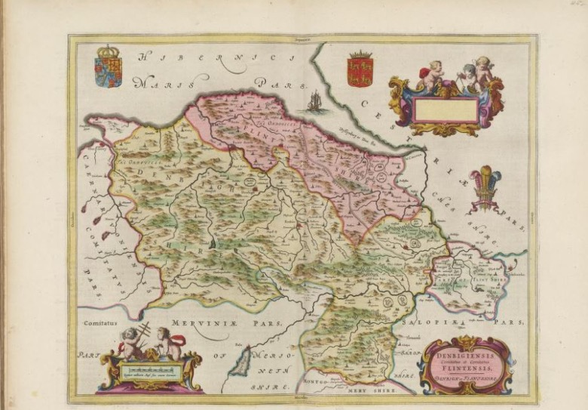
What is a Map?
Maps have lots of different uses and have been made for hundreds of years.
As a class discuss the following:
Why do we need maps?
Where do we find maps?
How are maps useful as historical evidence?

Slide 3

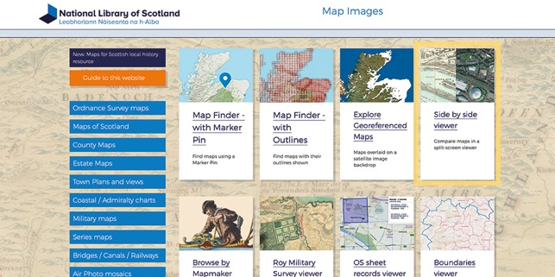
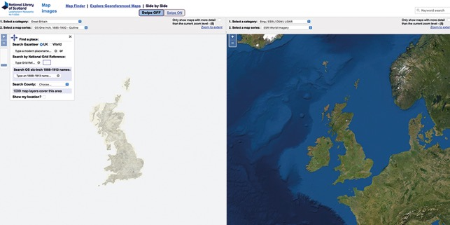

Exploring Maps
The National Library of Scotland has many historical maps that are available to view online.
Go to National Library of Scotland website: https://maps.nls.uk/
Click
Side by side viewer tab

Slide 4
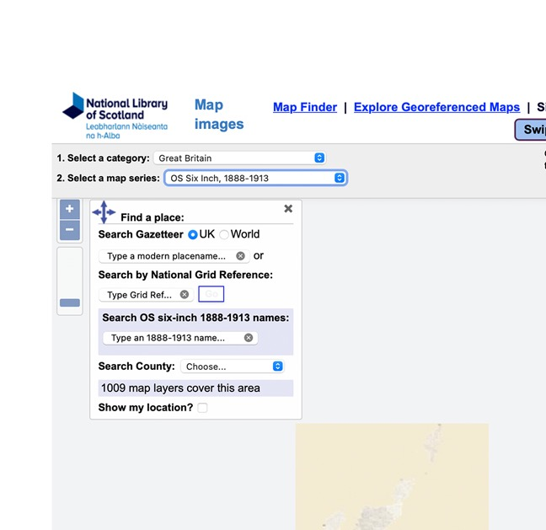
Exploring Maps – Step 1
To explore a historic map, click the drop-down menu 2 at the top left of the page and select “OS six inch 1888-1913”.

Slide 5
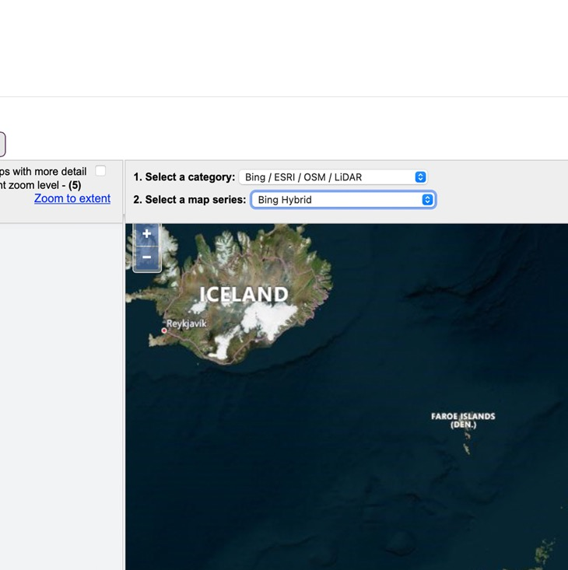
Exploring Maps – Step 2
Then select a modern map to compare by clicking on the right-hand map, then click the drop-down menu 2 and select “Bing Hybrid”.

Slide 6
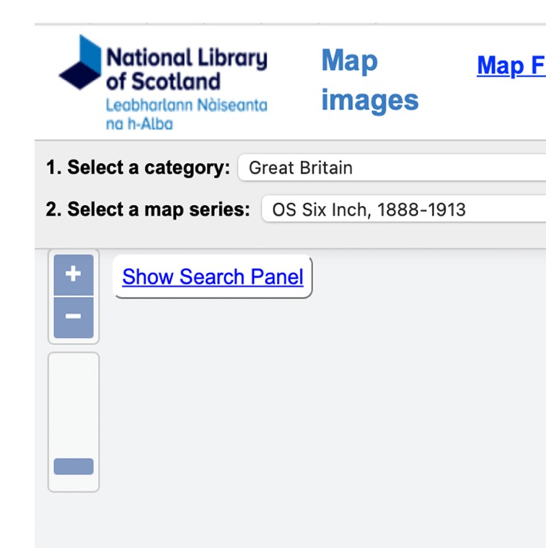
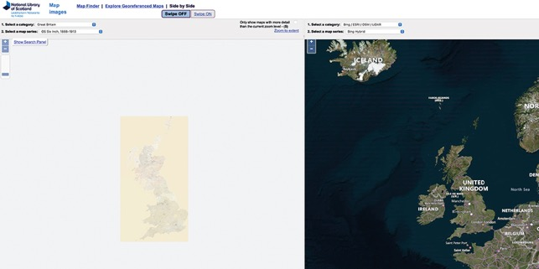
Exploring Maps – Step 3
Now you need to search for a place.
Let’s explore Cefn Mawr.
If it isn’t already open, click “show search panel” in the top left corner of the left map.

Slide 7
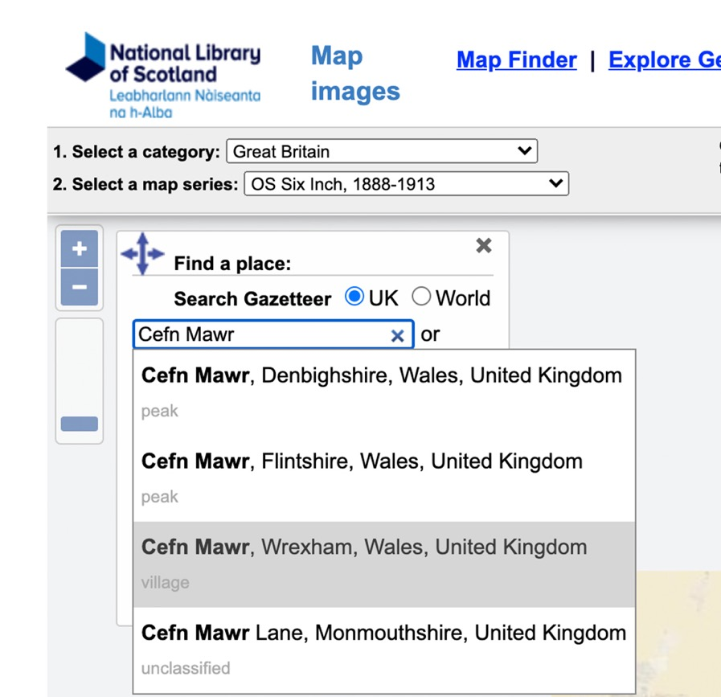
Exploring Maps – Step 4
In the first box type “Cefn Mawr” and from the options select “Cefn Mawr Wrexham”. This will take you to the right location to begin the tasks.
You can type in Cefn Mawr again if you get lost. Don’t worry about the other boxes in the search tool, you don’t need those.

Slide 8

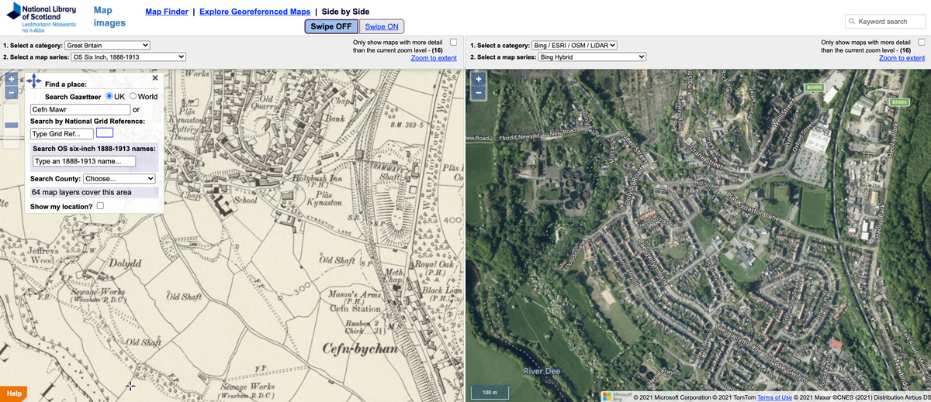
Exploring Maps – Step 5
Now you are ready to begin exploring!
You can zoom in and out with the mouse wheel to explore the area around Cefn Mawr and Pontcysyllte Aqueduct and Canal. Clicking anywhere on the map and holding the cursor down enables you to move the map around to see a different area.

Slide 9
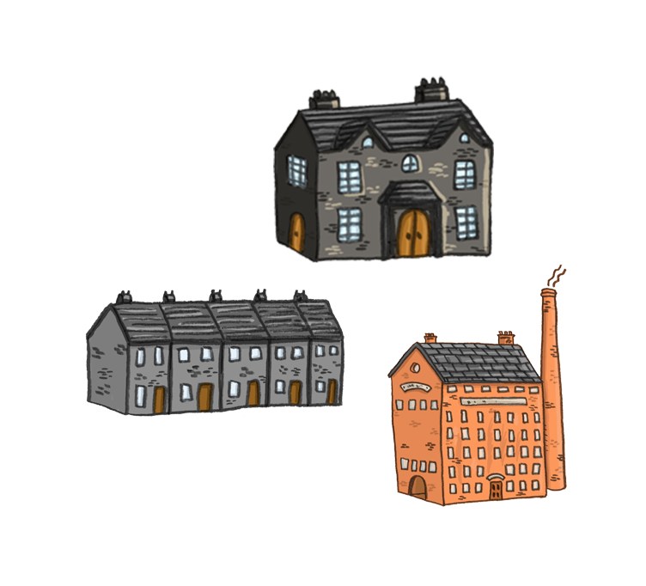

Activity 1: Analyse and Investigate
The side-by-side viewer allows you to see the same area of a place in two different time periods. This is useful to see changes over time.
Use the maps side-by-side to explore the area around Cefn Mawr and compare the Victorian map to today’s satellite view and answer the questions below:
1. Which map has more houses the Victorian map or today?
2. Can you find Pontcysyllte Aqueduct and the canal?
3. Find Plas Kynaston Chemical Works. Is it still there today?
4. What other differences can you see from comparing the two maps?
5. Is there anything that hasn’t changed?

Slide 10
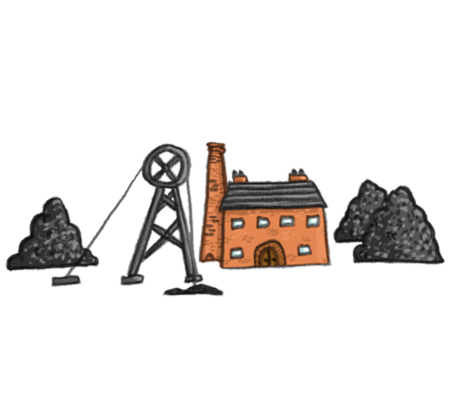
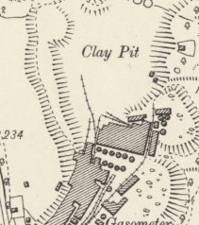
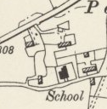
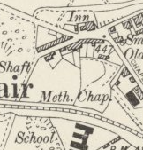
Activity 2: Data Collection
Have a discussion about the industries that employed people in the past. What are quarries, collieries and mineshafts?
Explore the area around Cefn Mawr then record your findings on the table on the next slide.
How many of these industries and buildings can you find on each map, the Victorian map and the modern map?
Quarries
Coal mines - look for collieries, old mine shafts and spoil heaps
Clay industries - look for brick, fireclay and tile works or potteries
Iron industries – look for foundry and smithy
(sometimes shortened to Smy)
Churches and Chapels (sometimes shortened to Chap)
Schools (sometimes shortened to Sch)

Slide 11
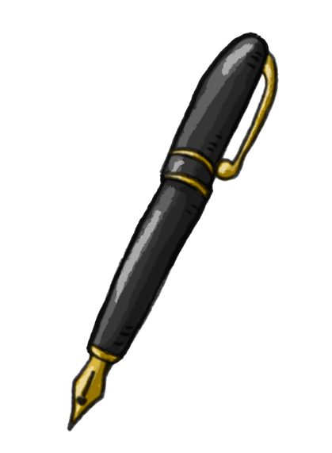
Map Data Recording Table
How many? | Victorian map | Modern Map
Quarries
Signs of coal mining
Clay industries
Iron industries
Churches and Chapels
Schools
Can you analyse the data and present it in a graph?
What do the results tell you about the Cefn Mawr area in the past and today?

Slide 12
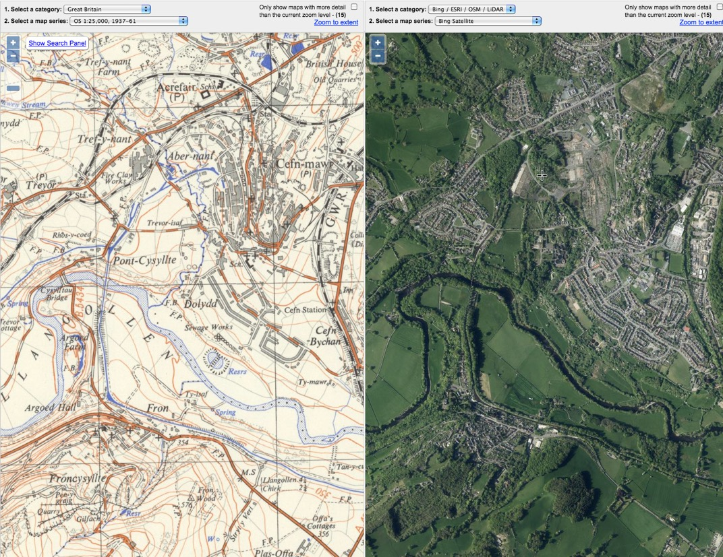
Further Activities
Explore some of the other maps on the National Library of Scotland website. You can choose a different map to view using the drop-down menus “Select Map Series”.
Try selecting OS 1:25000, 1937-61 and a modern satellite map. Can you find the canal and follow its course?
Why not use the maps to explore the area around your school or your own house and identify the changes over time?
Well done map explorers!

