Slide 1
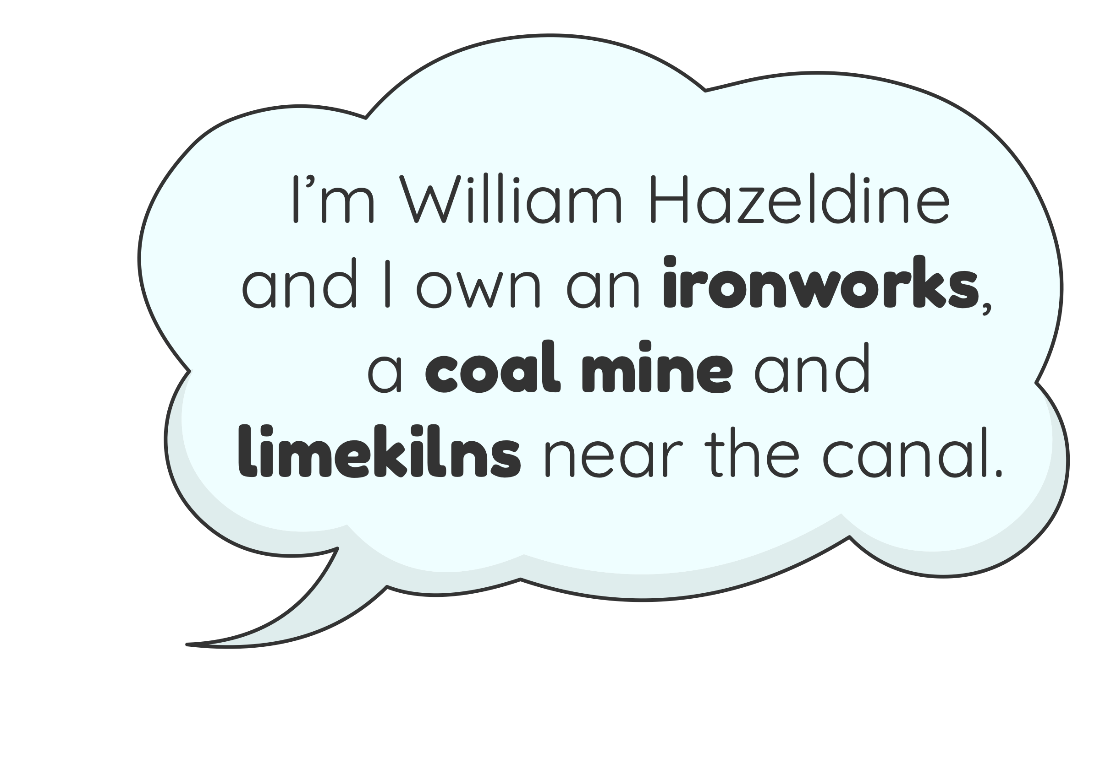
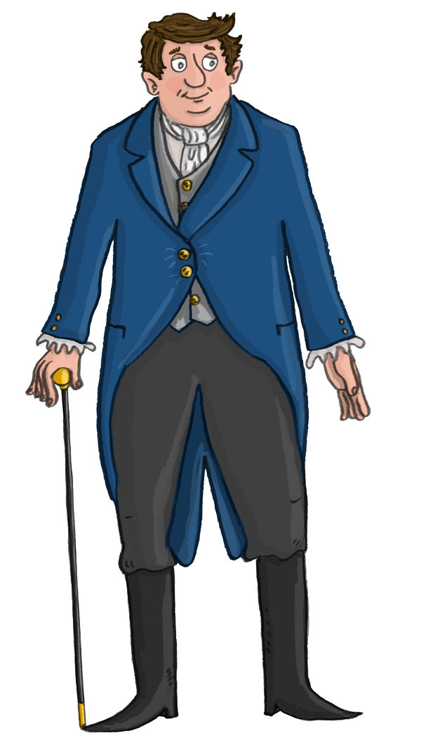
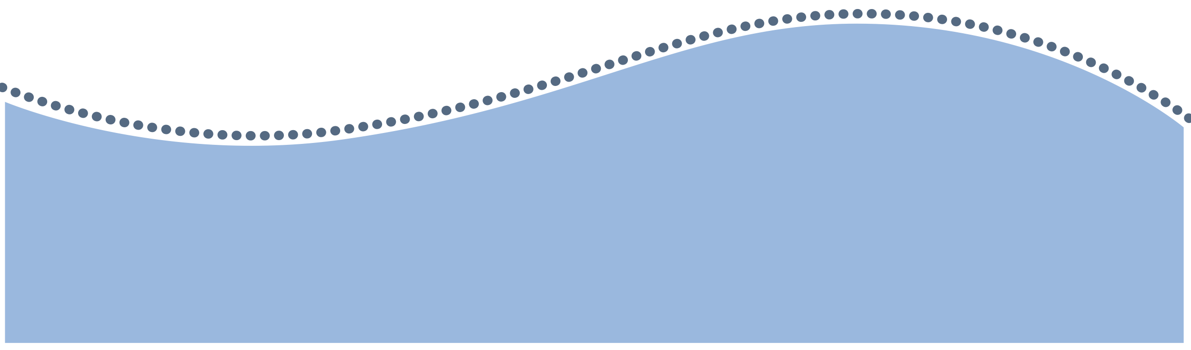
Trade and Industry
www.pontcysyllte-aqueduct.co.uk

Slide 2
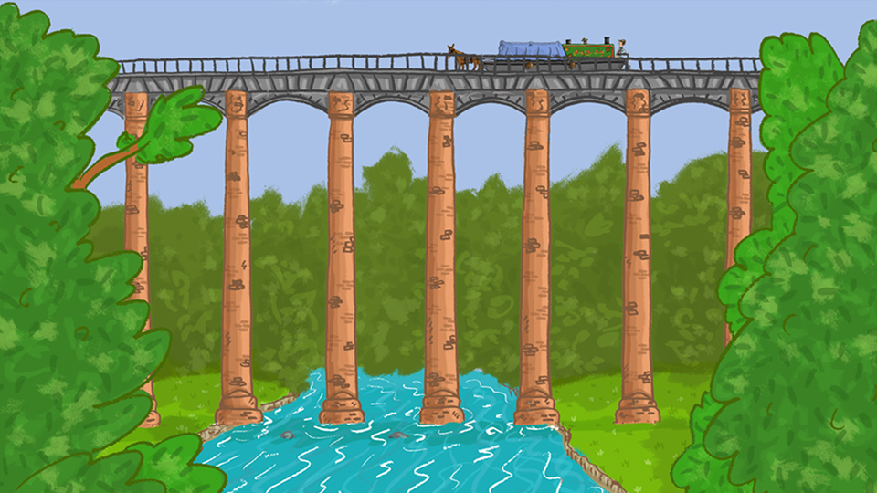
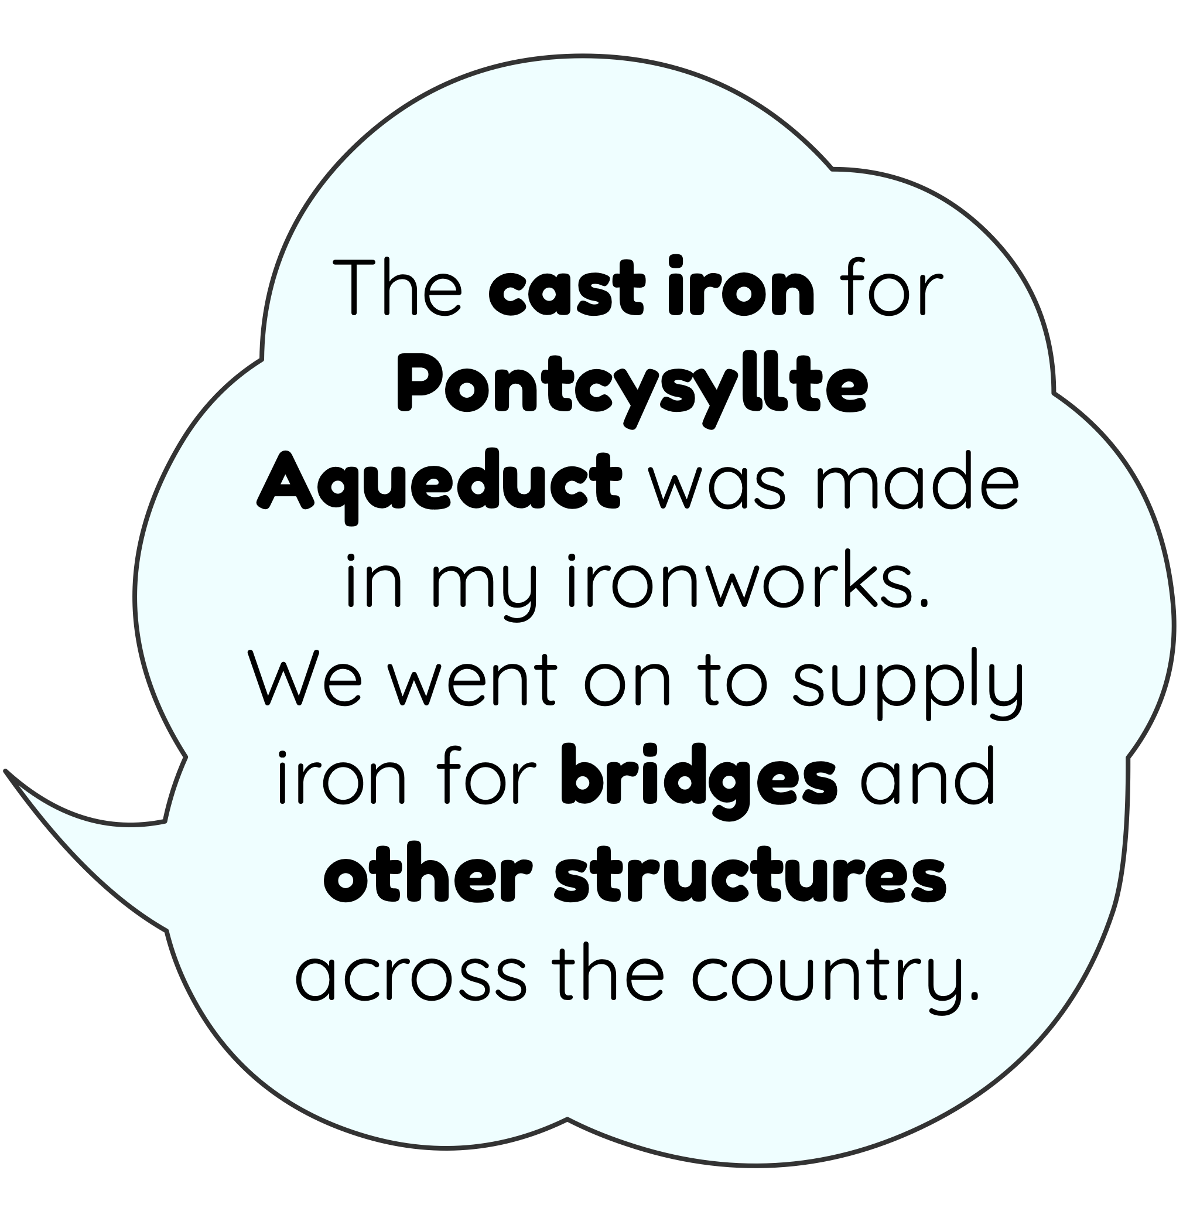
Let’s find out how the canal helped trade and industry to grow.

Slide 3
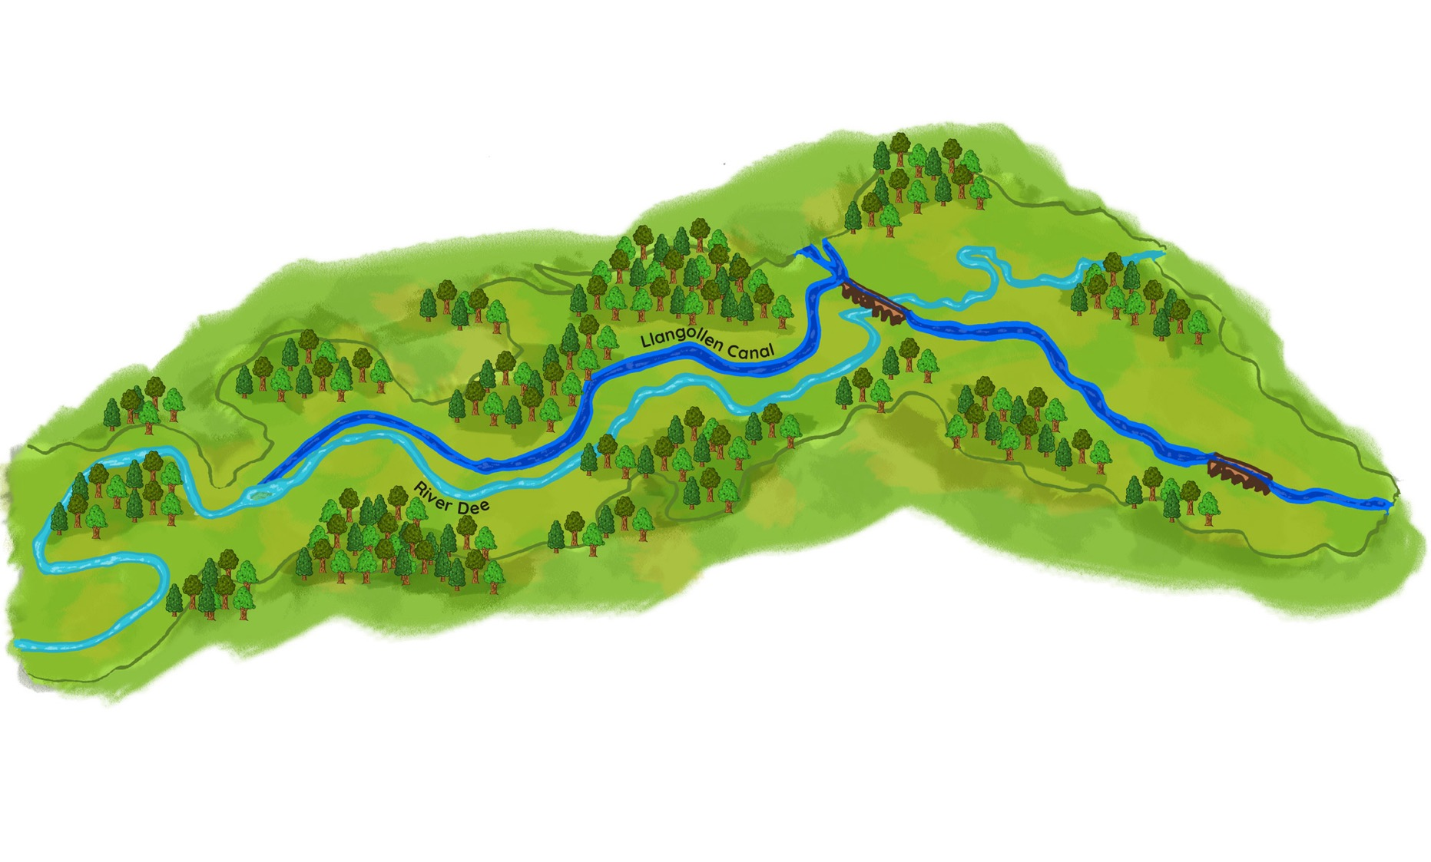

Raw Materials in the Dee Valley
Lots of important raw materials like coal, limestone, sandstone, clay and slate were found in the Dee Valley.
Coal
Iron
Clay
Sandstone
Limestone
Clay
Coal
Slate
CHIRK
LLANGOLLEN
Limestone
Slate
Coal

Slide 4
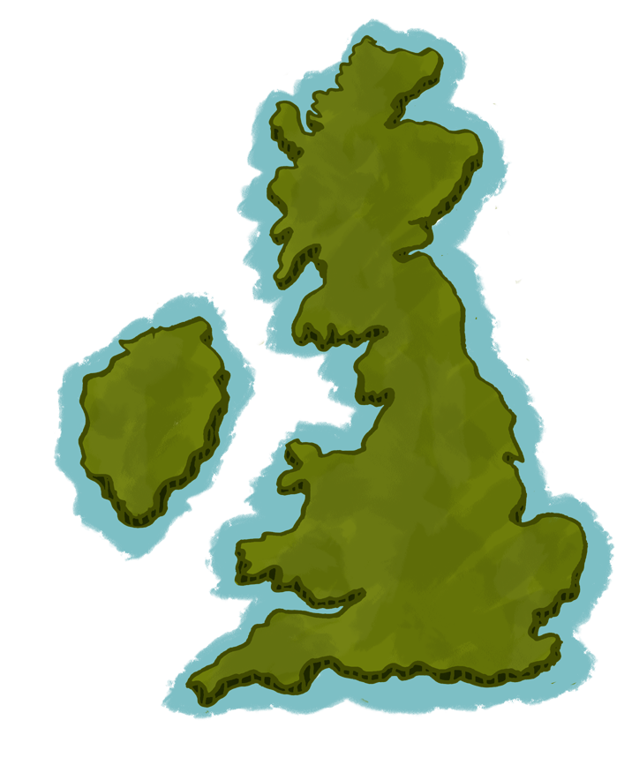

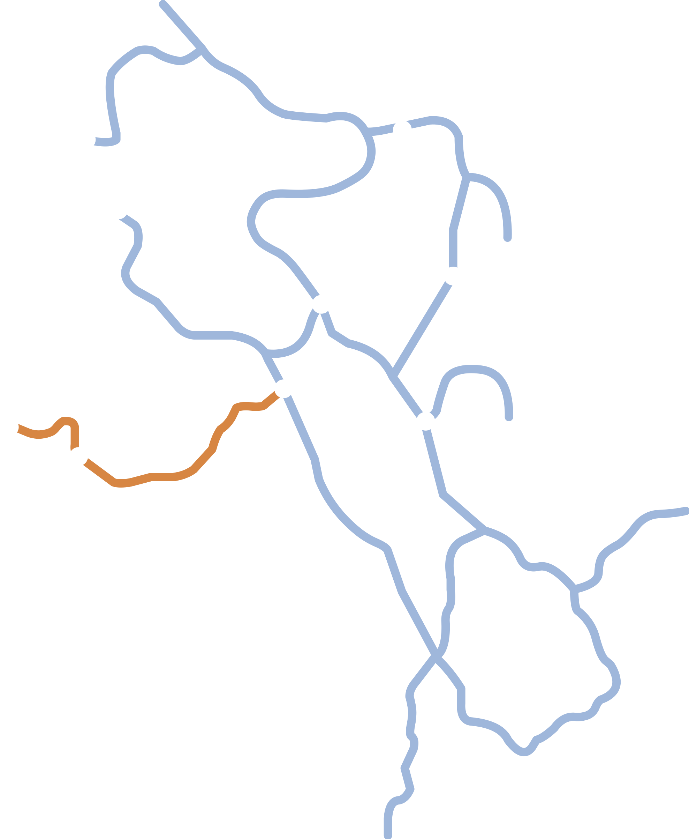
Liverpool
Manchester
As industrial towns and cities grew in the Midlands and the north-west of England, demand for raw materials increased.
By linking to these areas, the canal enabled the materials to be transported cheaply to the growing markets.
Chester
Llangollen
Stoke-on-Trent
Llangollen Canal
Birmingham

Slide 5
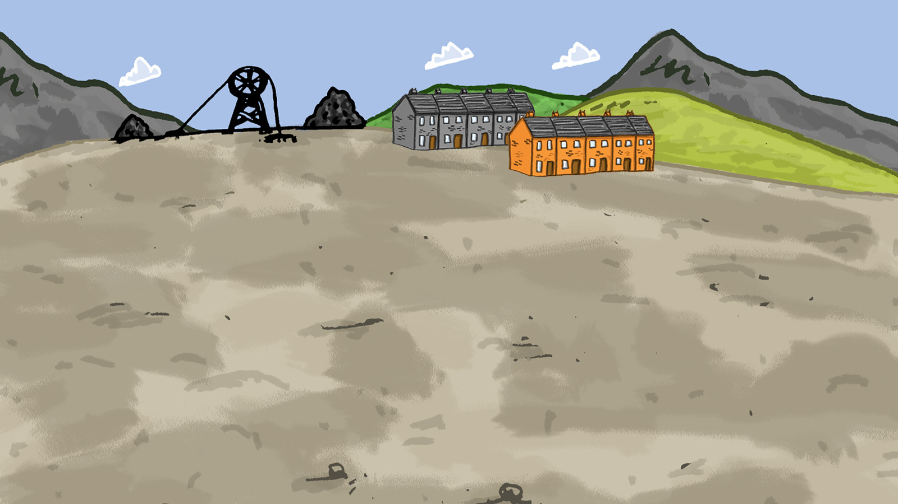

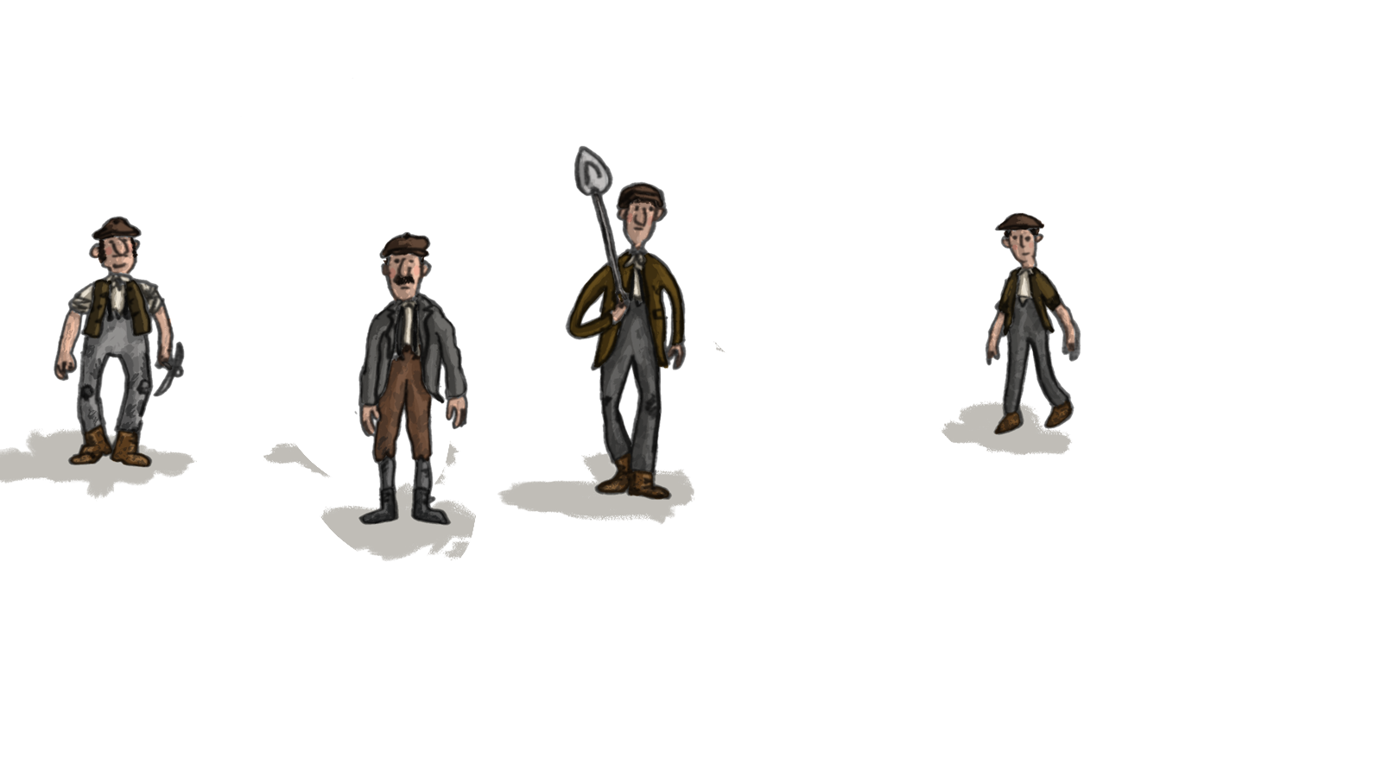
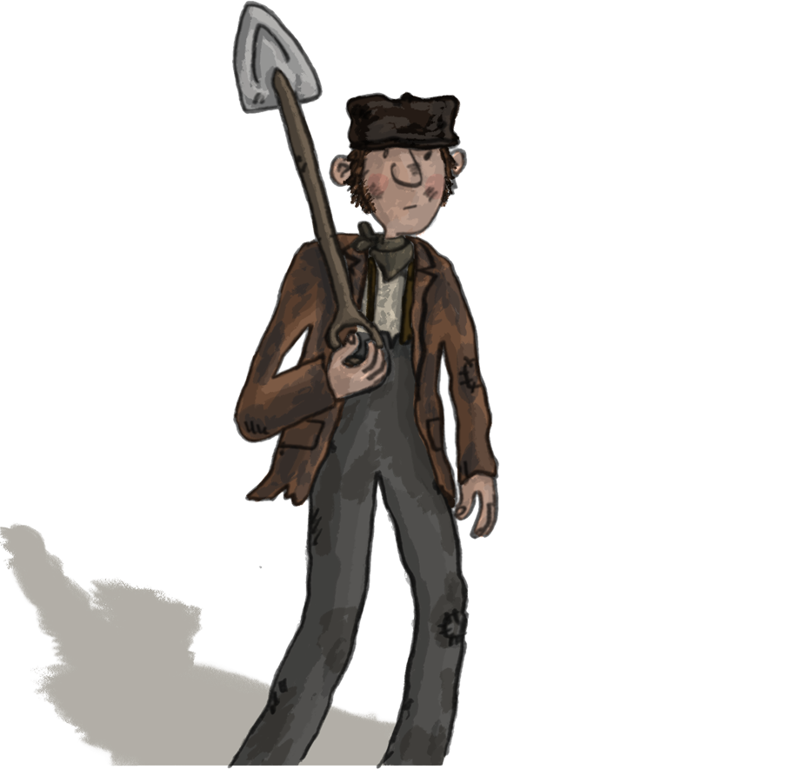
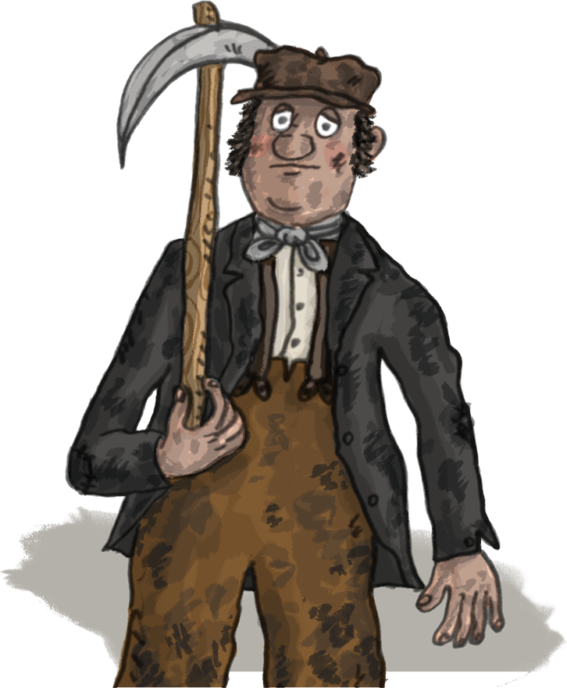
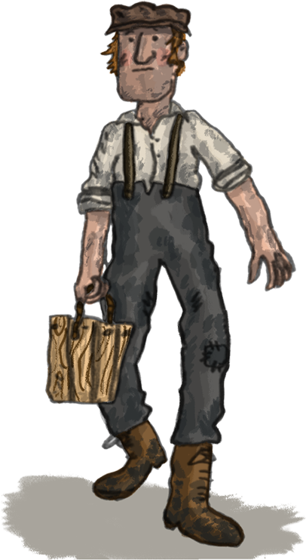

Industries expanded and towns and villages grew to house the growing workforce.

Slide 6
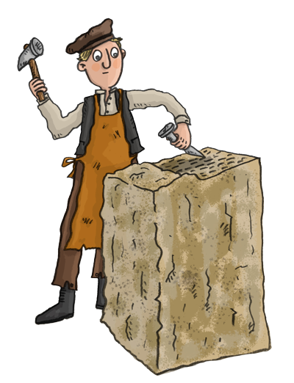
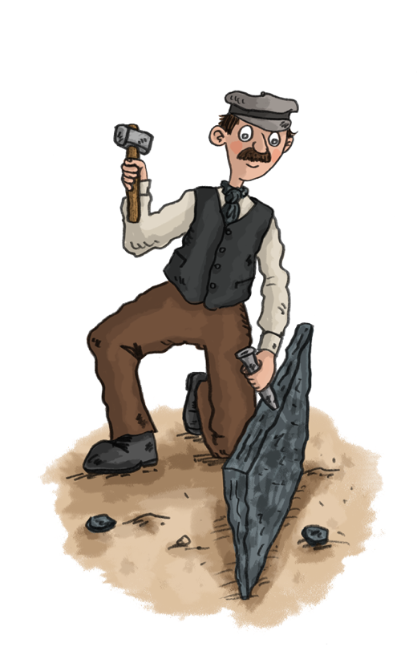
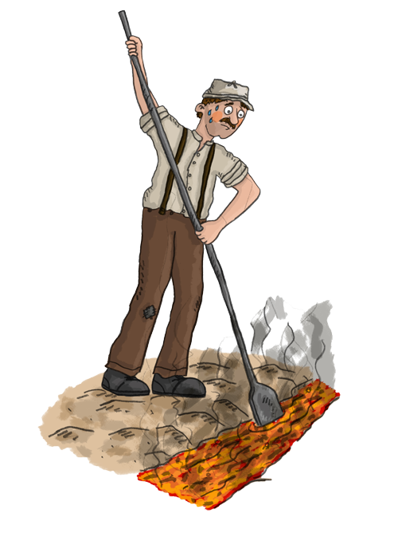
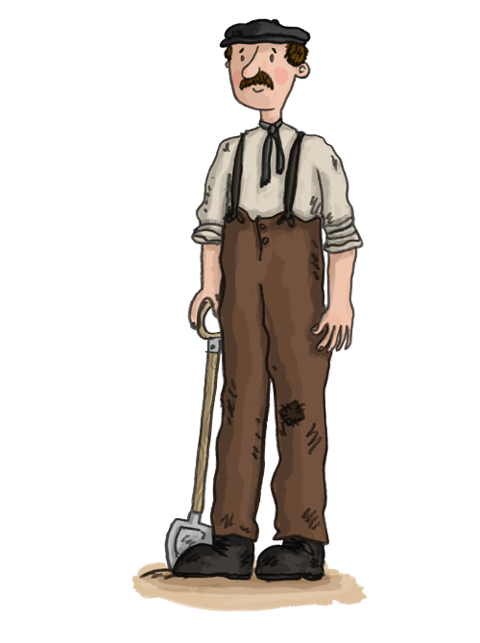
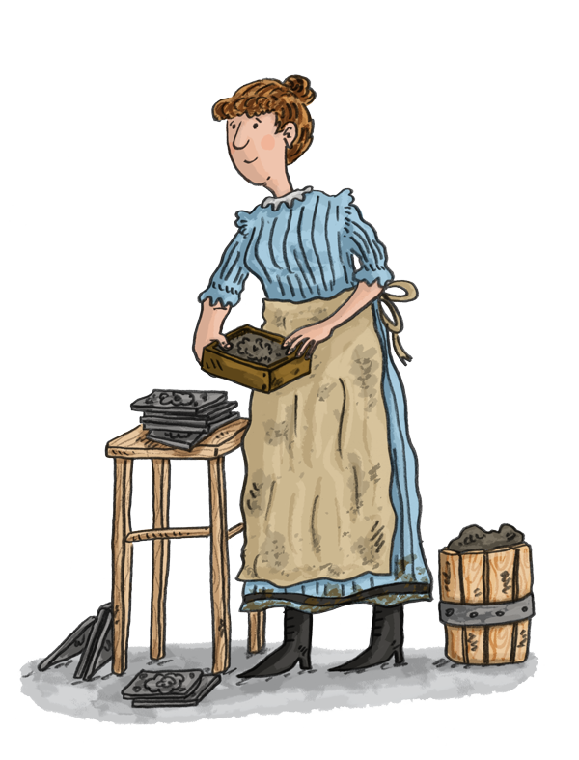
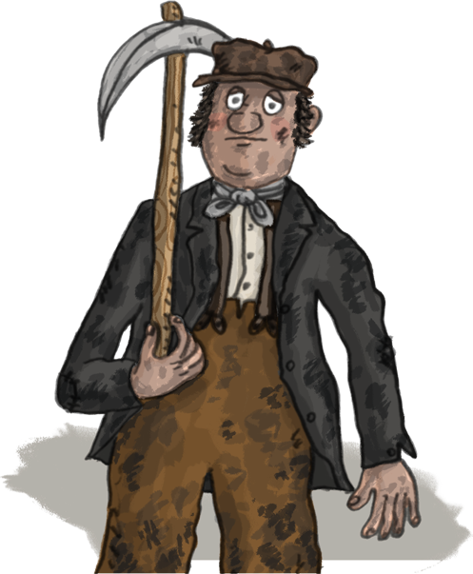
Industries in the Dee Valley
Sandstone
Iron
Industries grew along with towns and villages to house the growing workforce.
Limestone
Slate
Brick & Tile
Coal

Slide 7
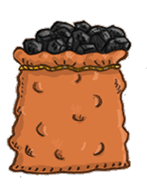
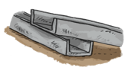

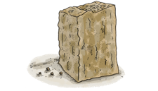
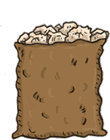
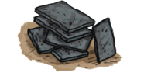



Industries in the Dee Valley
= Tramway
The quarries and coal mines expanded and tramways were built linking them to the canal.
Ironworks and brickworks opened using the local ironstone and clay. Limekilns were built alongside the canal.
Coal Mines
Ironworks
Brick and Tileworks
Limestone Quarries
Sandstone Quarry
Slate Mill
Brick and Tileworks
Slate Quarry
Coal Mines
LLANGOLLEN
CHIRK
Limekilns
Limestone Quarries
Slate Quarry
Coal Mines

Slide 8
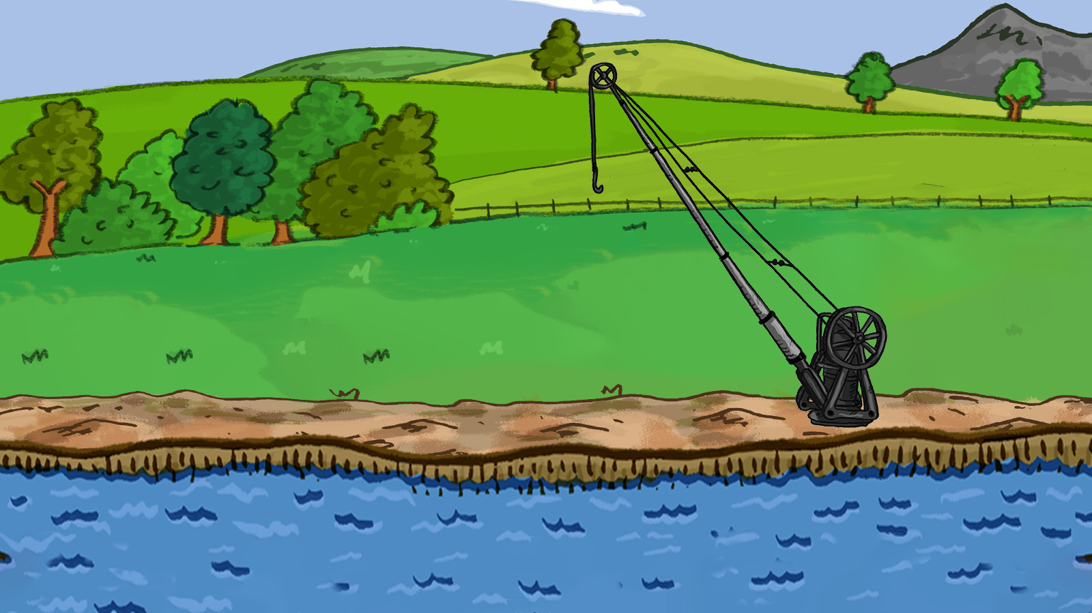
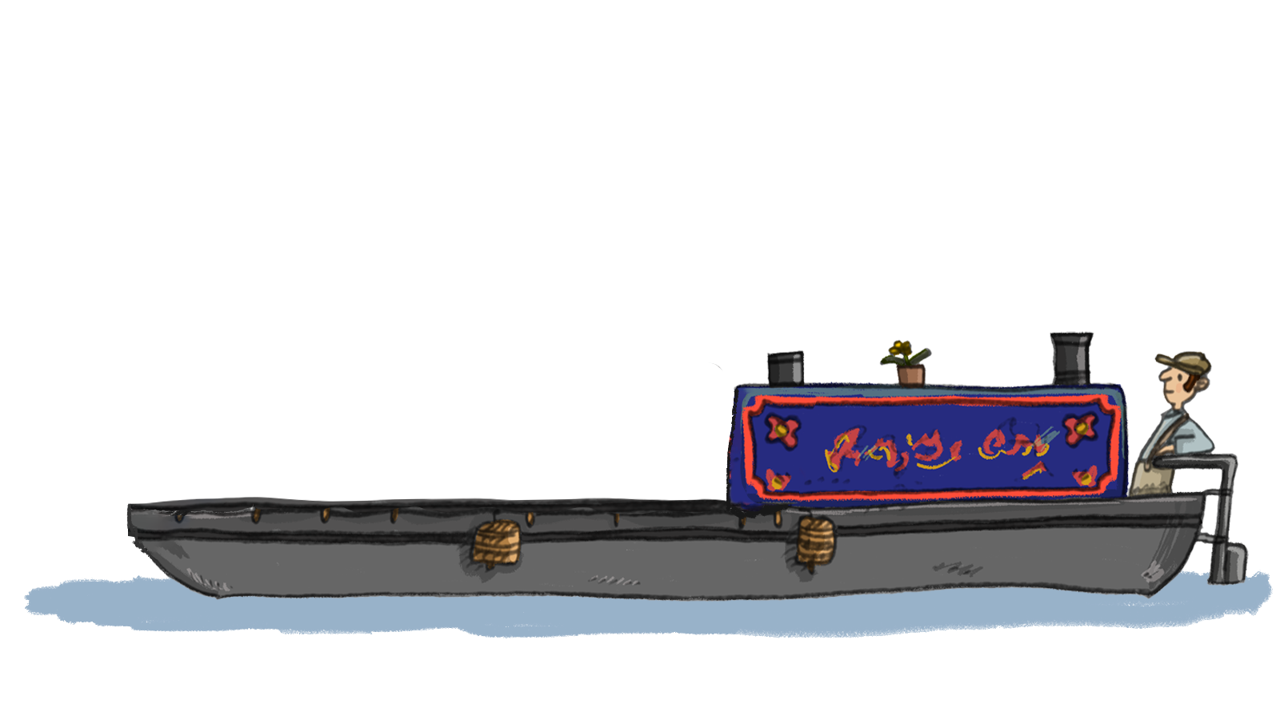
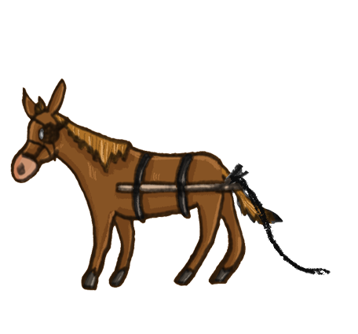
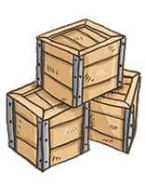
The raw materials found near the canal were used in many ways. They, or the products made from them, were transported along the canal and sometimes ended up far away.

Slide 9
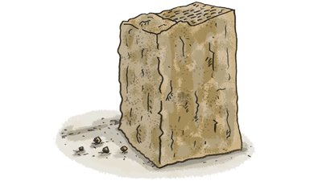
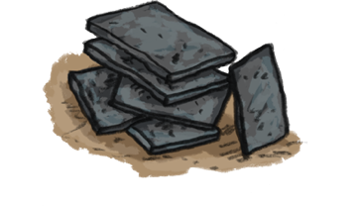
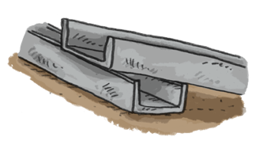
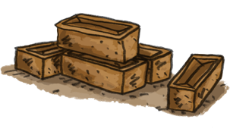
Raw Materials Quiz
Let’s play a game to see if you can guess what these raw materials were used for and where they ended up.
Instructions
Click on each square to reveal a section of the picture – after each click try to guess what the raw material might be.
Let’s play…

Slide 10


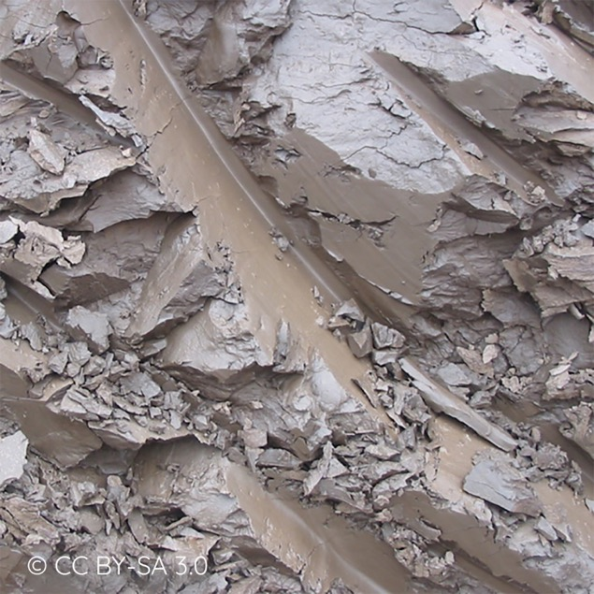
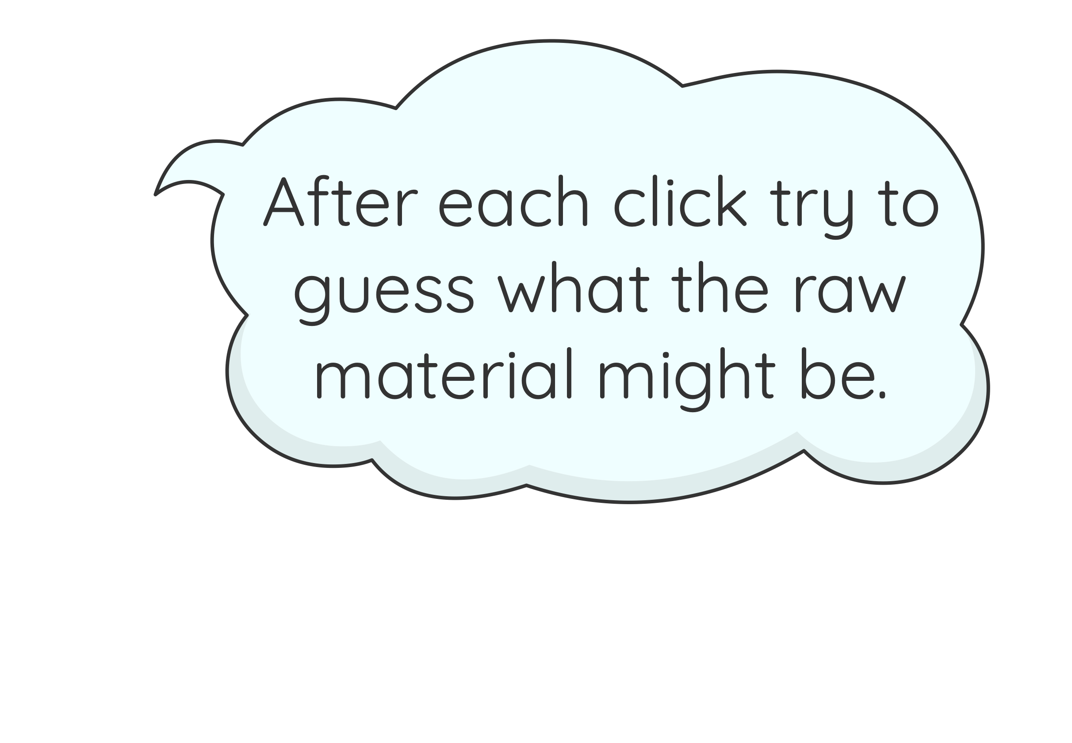
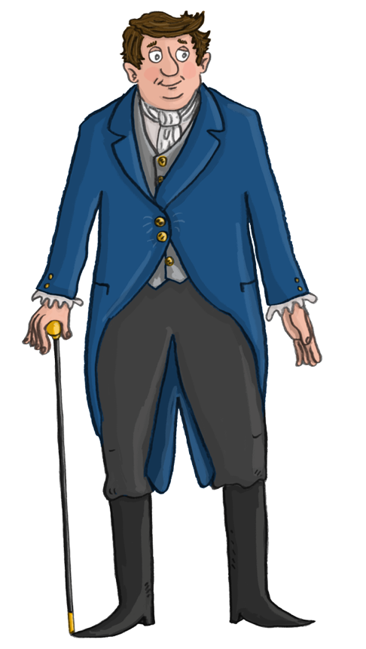
Mystery Raw Material One
Click on each square to reveal a section of the picture.
Click here
to see the answer…

Slide 11
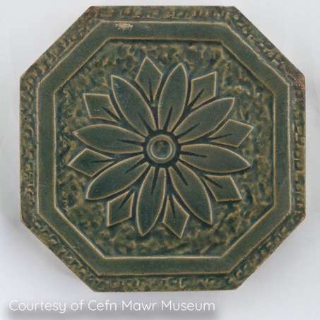
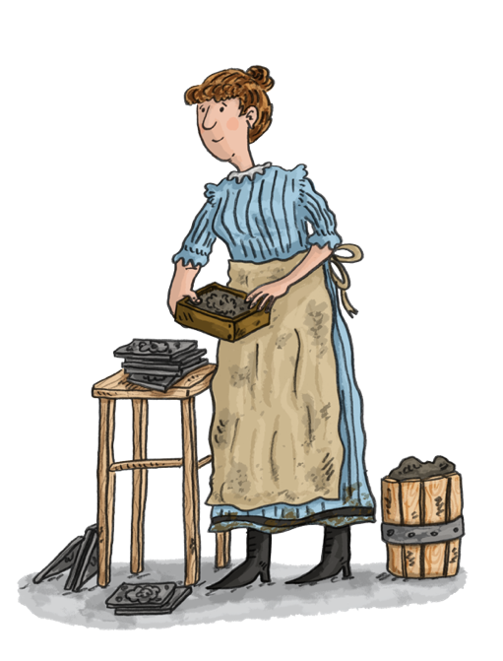
Mystery Raw Material One - Clay
Clay is soft and sticky when wet and can be moulded into different shapes but bakes hard when it is heated.
© David Heke
What was it used for?
Clay
This is a clay tile. It was made in J.C. Edwards Brick and Tile Works.

Slide 12
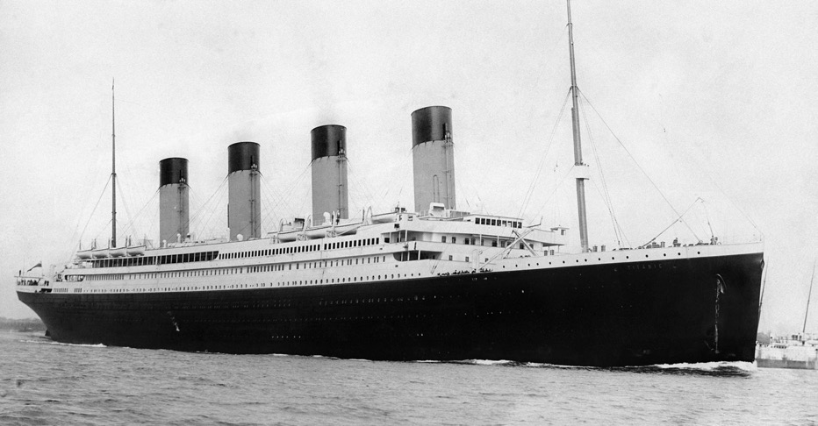
Mystery Raw Material One - Clay
Where might it have been used?
© David Heke
J. C. Edwards tiles may have been used to decorate fireplaces on board the Titanic and their floor tiles were used in the kitchens!
Belfast
Ruabon
The Titanic was built in Belfast

Slide 13
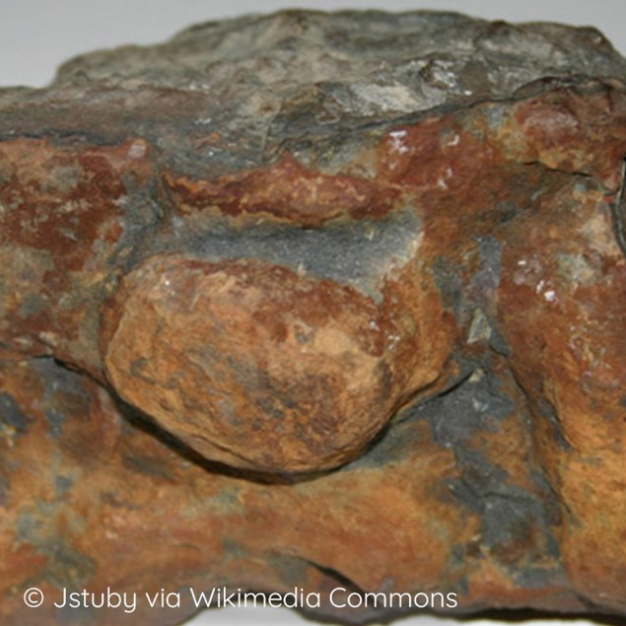
Mystery Raw Material Two
Click on each square to reveal a section of the picture.
Click here
to see the answer…

Slide 14
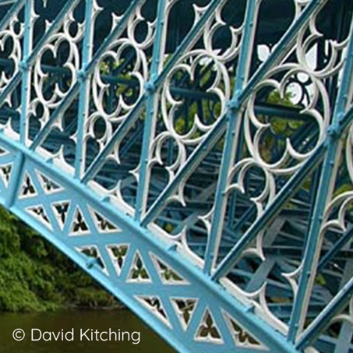
Mystery Raw Material Two - Iron
This is iron, a very hard metal that occurs naturally in ironstone, a common rock around Cefn Mawr.
What was it used for?
Iron
These are iron girders made at Plas Kynaston Ironworks in Cefn Mawr.

Slide 15
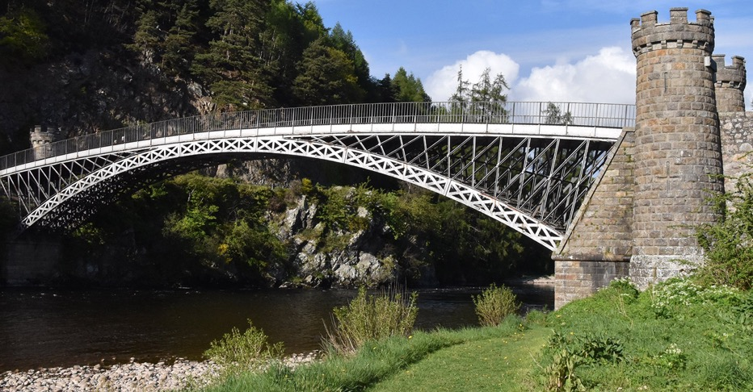
Mystery Raw Material Two - Iron
Where was it used?
Craigellachie Bridge in Moray, Scotland. Thomas Telford used Plas Kynaston iron in many of his projects around the country.
Moray
Plas Kynaston
© Nathan Holth, HistoricBridges.org

Slide 16
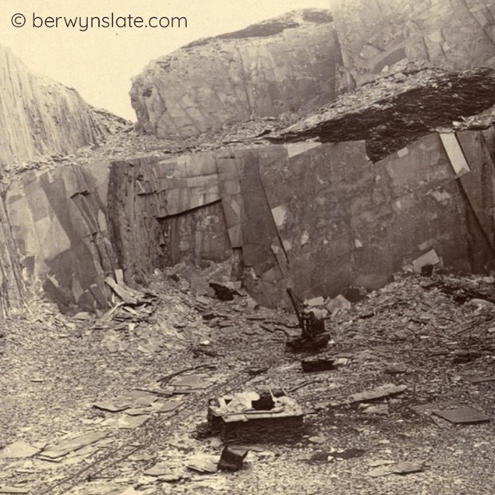
Mystery Raw Material Three
Click on each square to reveal a section of the picture.
Click here
to see the answer…

Slide 17
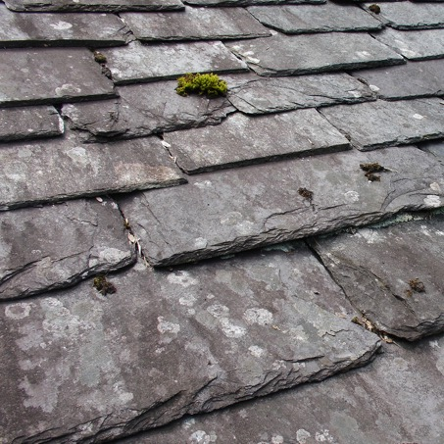
Mystery Raw Material Three - Slate
This is slate. It was quarried from the hills above Glyn Ceiroig and Llantysilio.
It is durable and can be split into pieces of different thicknesses with a very flat surface.
What was it used for?
These are roofing slates.
Slate

Slide 18
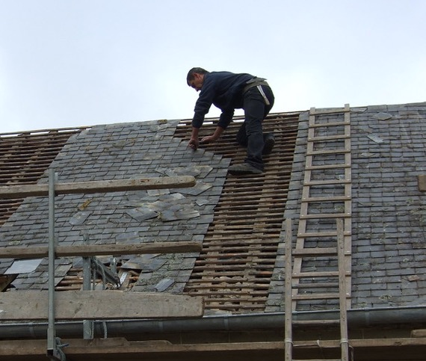
Mystery Raw Material Three - Slate
Where might it have been used?
Slates from the Ceiriog Valley were transported to London for roofing. Slabs from Pentrefelin were used for many things, including floors, gravestones and troughs.
Glyn Ceiriog
London

Slide 19
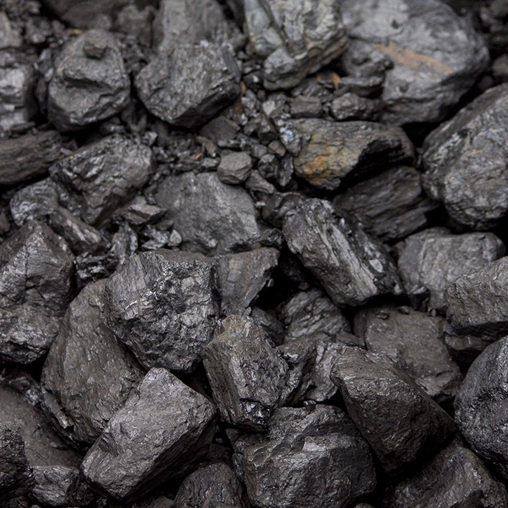
Mystery Raw Material Four
Click on each square to reveal a section of the picture.
Click here
to see the answer…

Slide 20
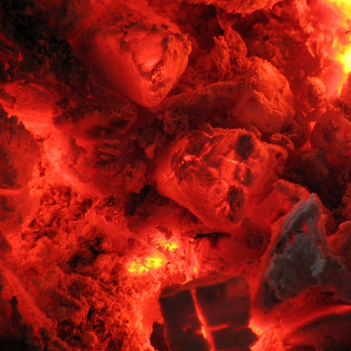

Mystery Raw Material Four - Coal
Coal was mined around Cefn Mawr and Chirk.
What was it used for?
Coal
Coal fires to heat homes and power industries.

Slide 21
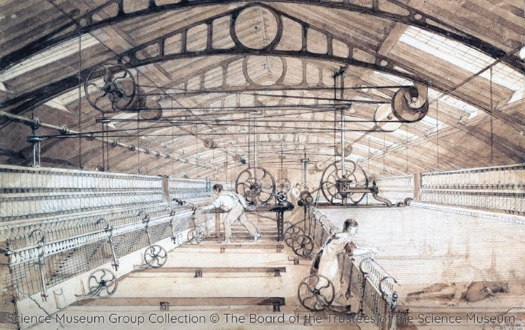
Mystery Raw Material Four - Coal
Where might it have been used?
The coal was transported along the canal to towns and cities. Some may have been used to power cotton mills in Manchester.
Manchester
Cefn Mawr

Slide 22
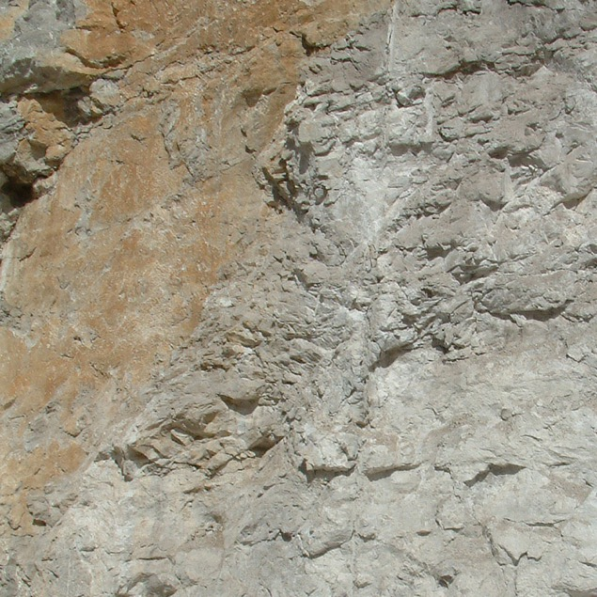
Mystery Raw Material Five
Click on each square to reveal a section of the picture.
Click here
to see the answer…

Slide 23
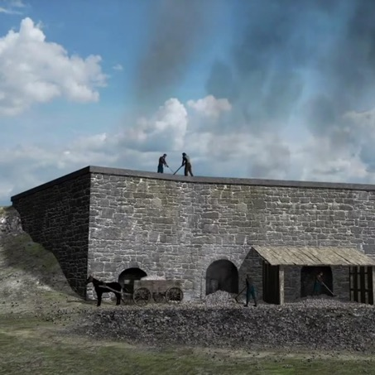
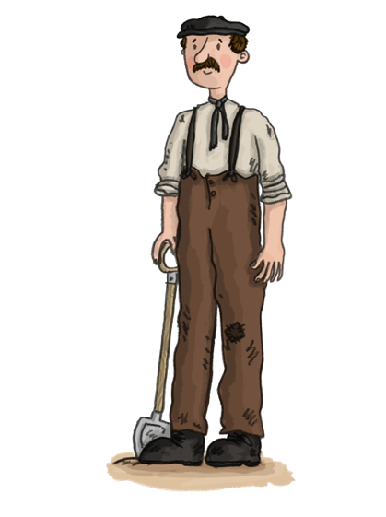
Mystery Raw Material Five - Limestone
This is limestone. It was quarried locally at Froncysyllte and Trevor.
Where was it used?
Limestone
Some limestone was burned in limekilns to make lime for use as fertiliser or as mortar for building.

Slide 24

Mystery Raw Material Five - Limestone
Where might it have been used?
Some of the lime made at Froncysyllte was used on farms in Cheshire and Shropshire to fertilise the soil.
Froncysyllte
Cheshire
&
Shropshire
© Worthington family

Slide 25

Mystery Raw Material Six
Click on each square to reveal a section of the picture.
Click here
to see the answer…

Slide 26

Mystery Raw Material Six - Sandstone
This is sandstone. It was quarried at Cefn Mawr.
Where was it used?
© Jeff Buck - CC BY-SA 2.0
Sandstone
The yellow sandstone of Cefn Mawr is such good quality that it has been used to build grand buildings since the 15th century.
St Giles’ Church, Wrexham

Slide 27


Mystery Raw Material Six - Sandstone
Where else was it used?
Cefn sandstone was used to build St George's Hall and the Walker Art Gallery in Liverpool.
© Rept0n1x, CC BY-SA 3.0, via Wikimedia Commons
St Georges Hall,
Liverpool
Walker Art Gallery,
Liverpool
Cefn Mawr
Liverpool
Creative Commons © Tony Hisgett

Slide 28


Mystery Raw Material Six - Sandstone
…and of course it was used for the
piers on Pontcysyllte Aqueduct!

