Slide 1
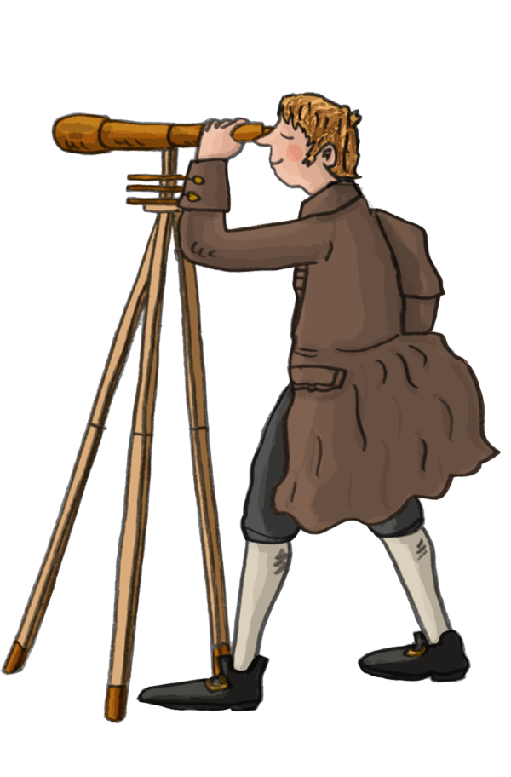
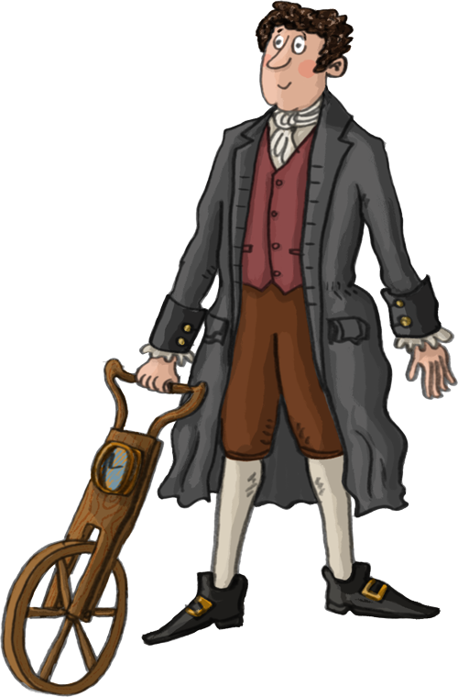
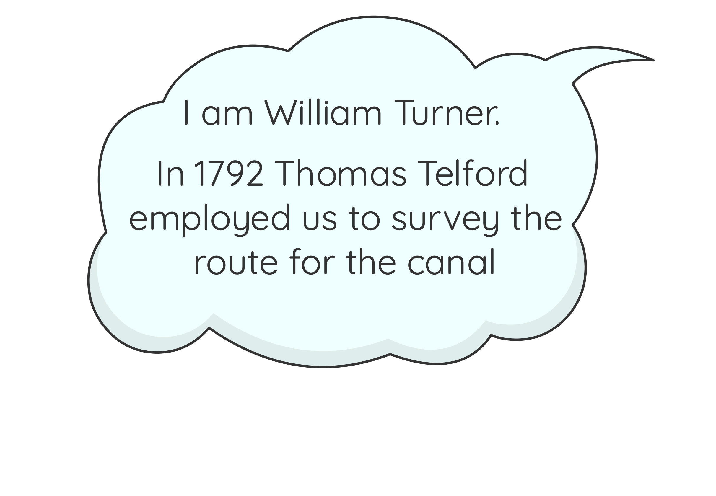

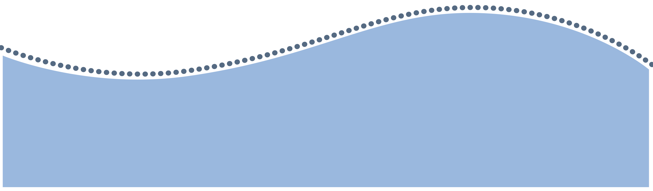
Surveyor’s Task: What challenges faced the canal builders?
William Turner
John Duncombe
www.pontcysyllte-aqueduct.co.uk

Slide 2
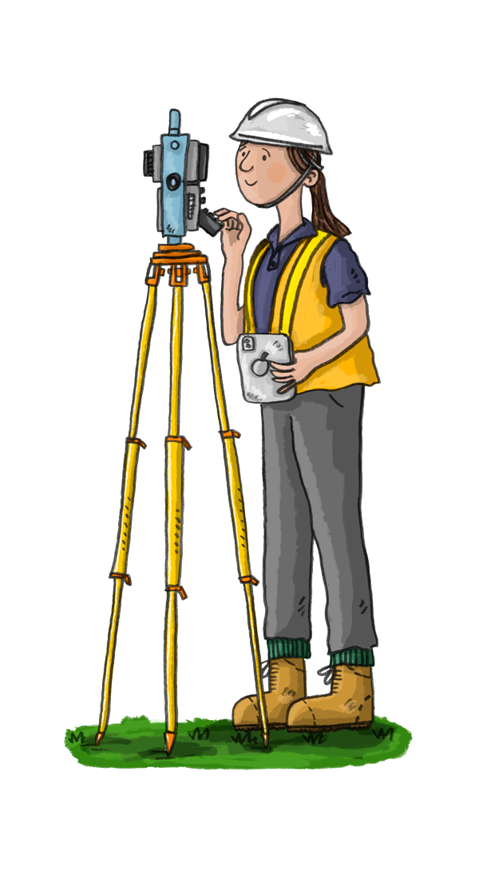
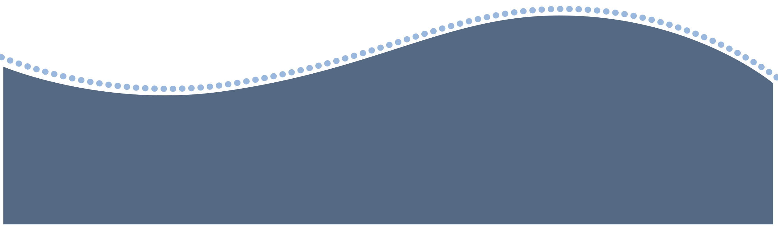
What is a Surveyor?
What do you think a surveyor is?
What kind of job do you think we do?
What tools do we use?
Have a discussion with your teacher and the rest of the class.

Slide 3

What is a Surveyor?
Surveyors work with engineers and builders to plan out and build roads, paths, bridges, rail lines and canals.
They find the best and cheapest route for the new transport link.

Slide 4
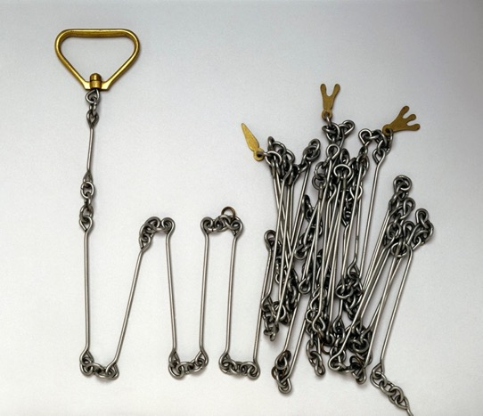
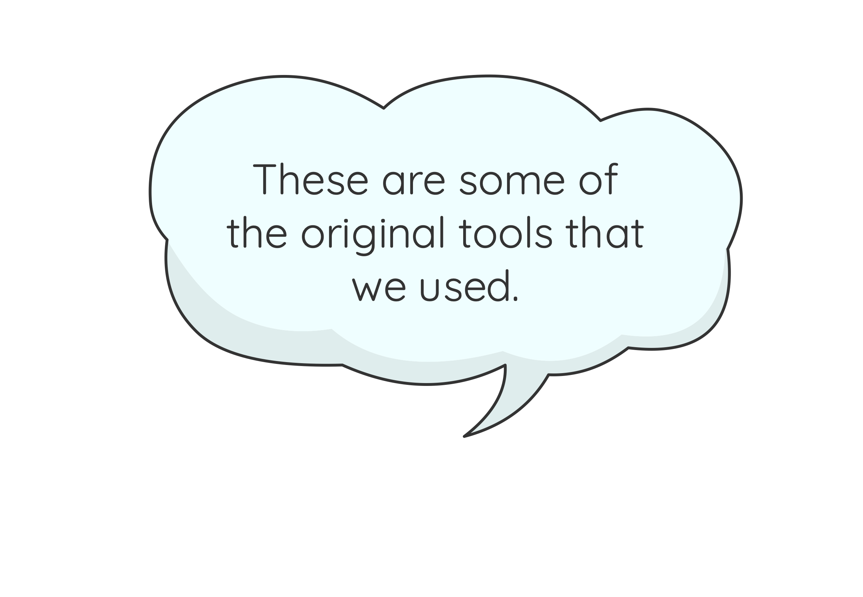
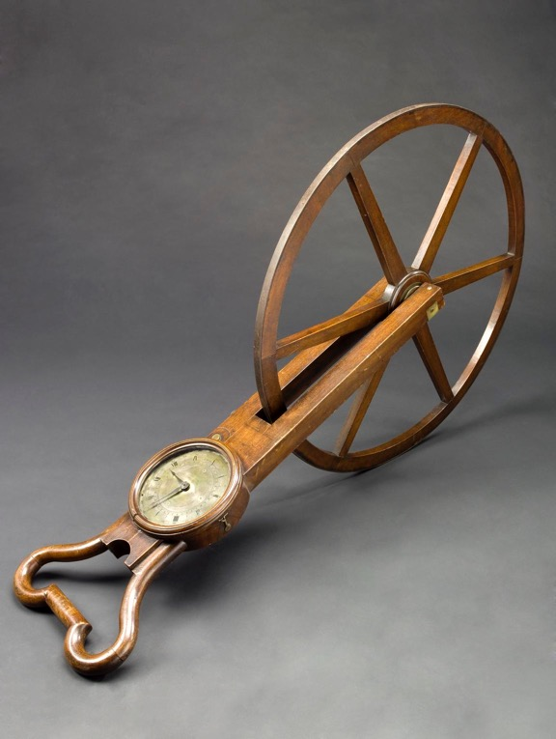
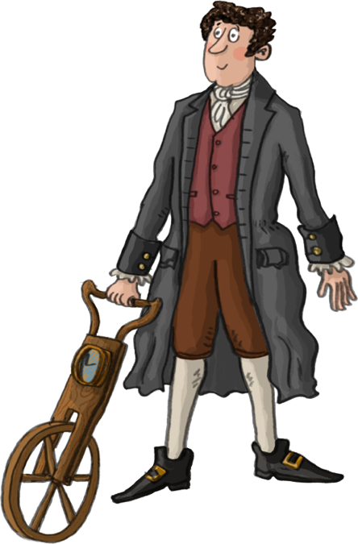

Surveying Tools
Science Museum Group Collection
© The Board of Trustees of the Science Museum
Science Museum Group Collection
© The Board of Trustees of the Science Museum
Surveyor’s chain
for measuring short distances
Waywiser
for measuring long distances

Slide 5
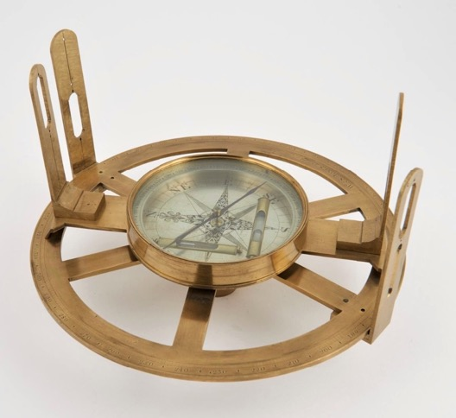
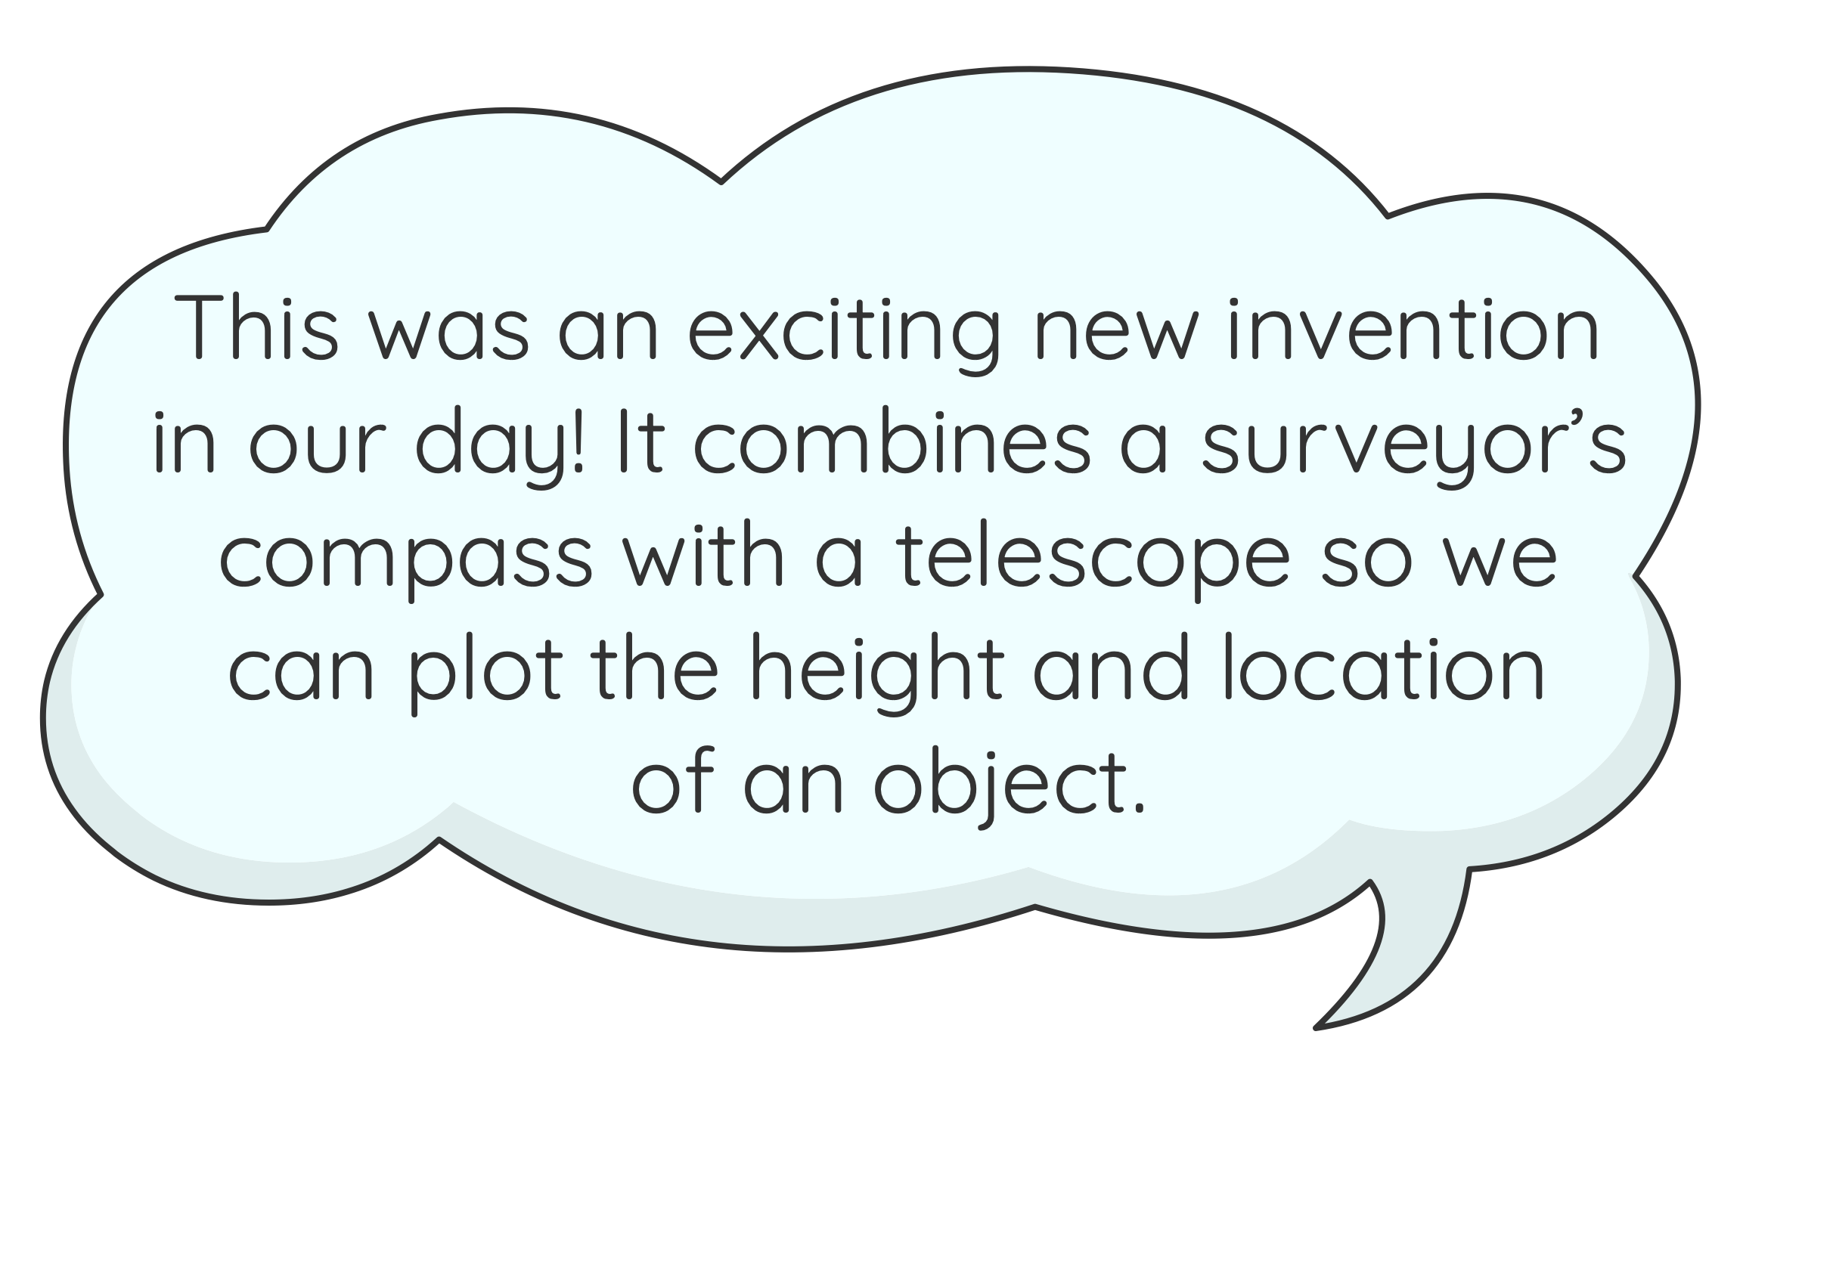
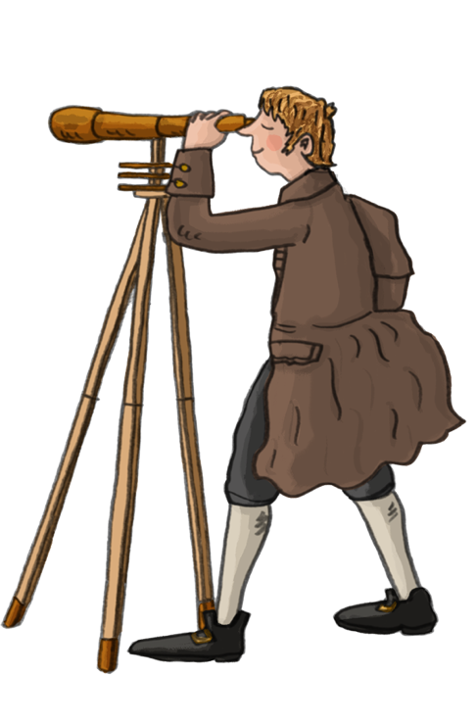
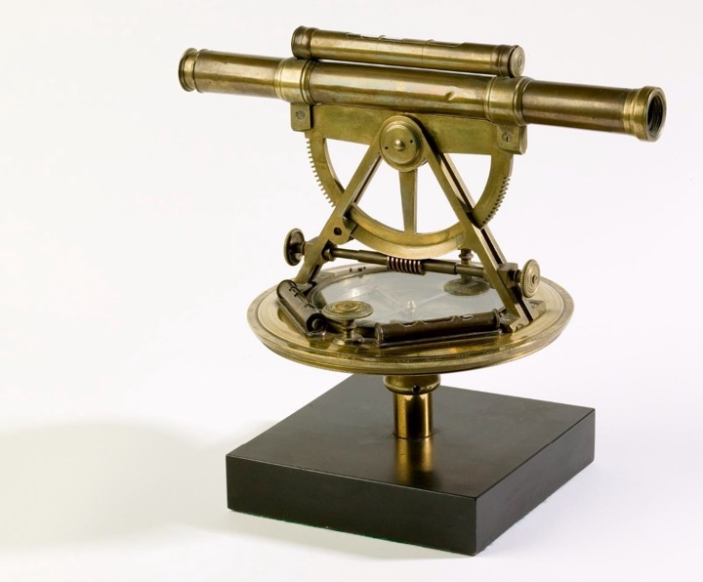
Surveying Tools
Science Museum Group Collection
© The Board of Trustees of the Science Museum
Compass
for finding direction
Theodolite
Science Museum Group Collection
© The Board of Trustees of the Science Museum

Slide 6
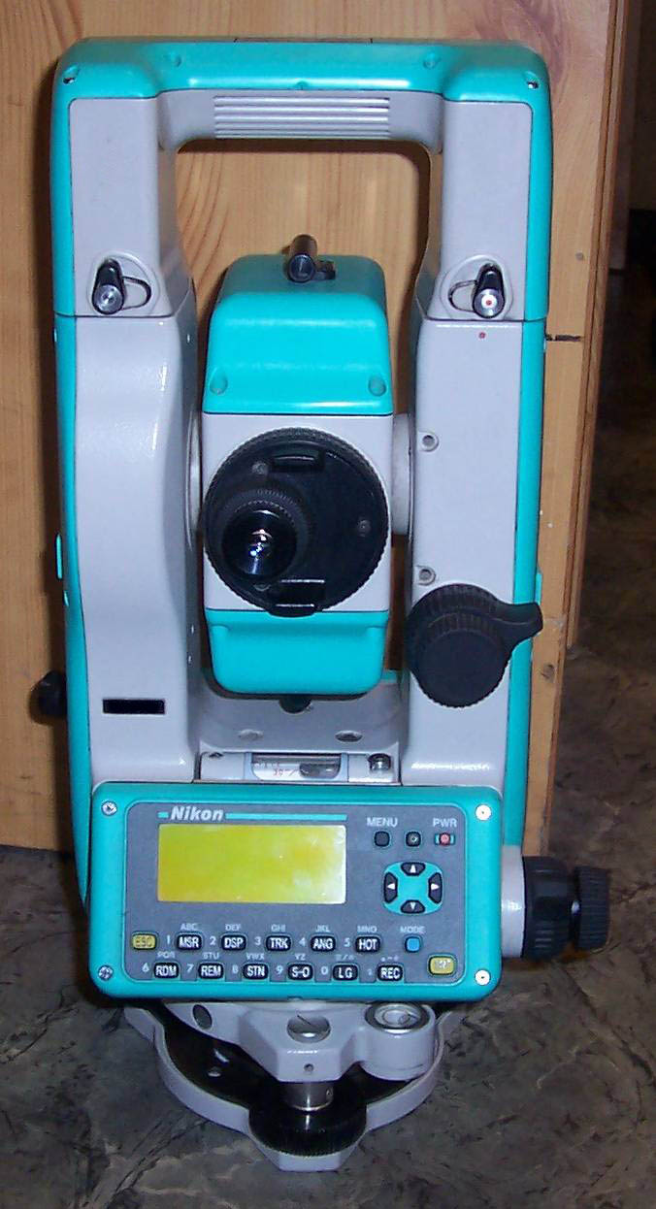
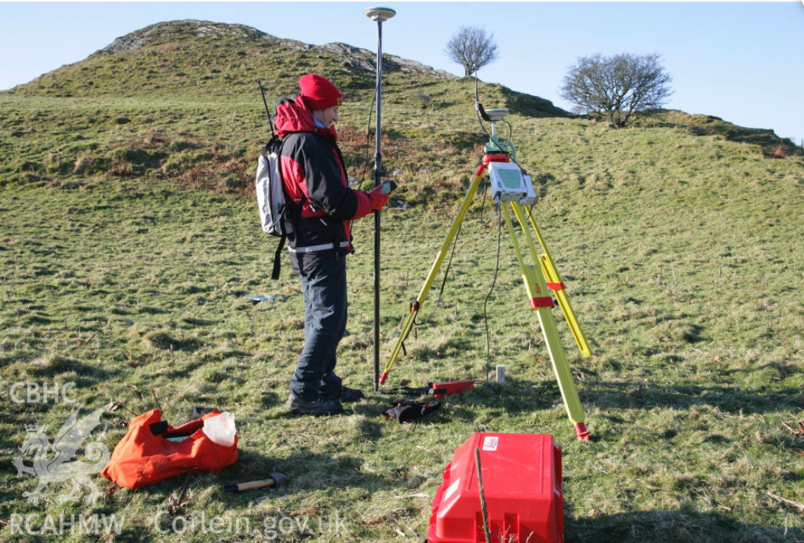
Modern Surveying
Electronic Distance Measuring Machine
© Crown Copyright: Royal Commission on the Ancient and Historical Monuments of Wales
Surveying using 21st century technology
© CC BY-SA 3.0, via Wikimedia Commons

Slide 7
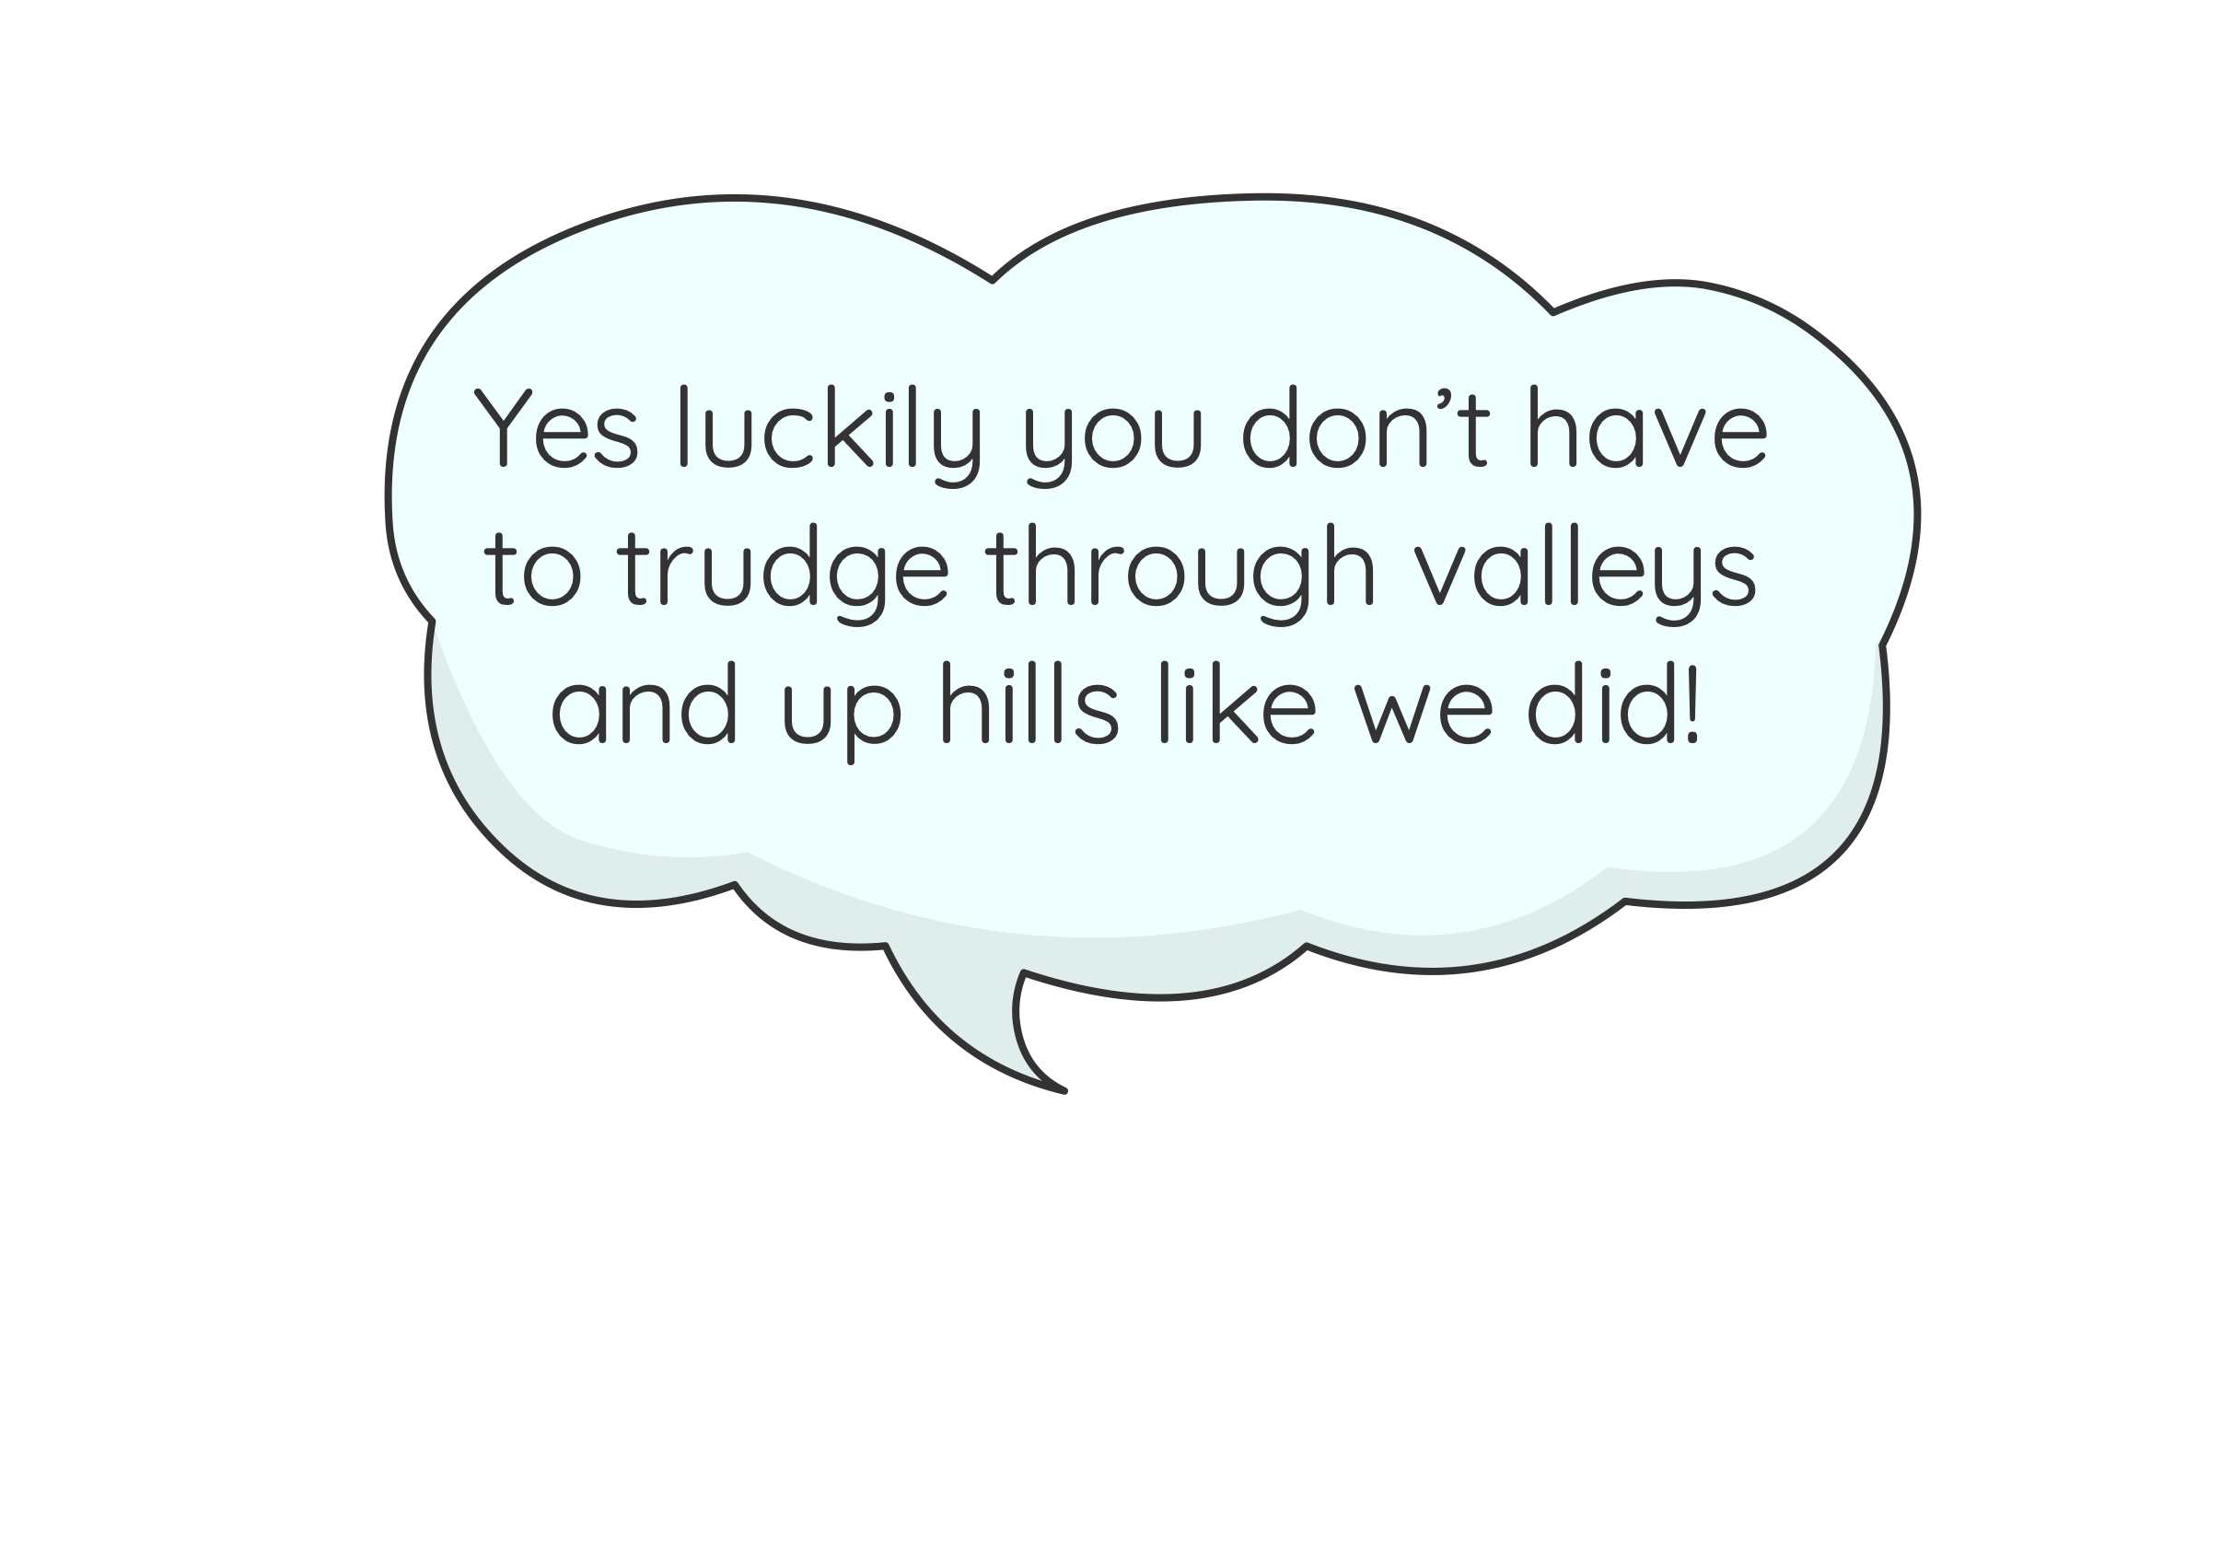
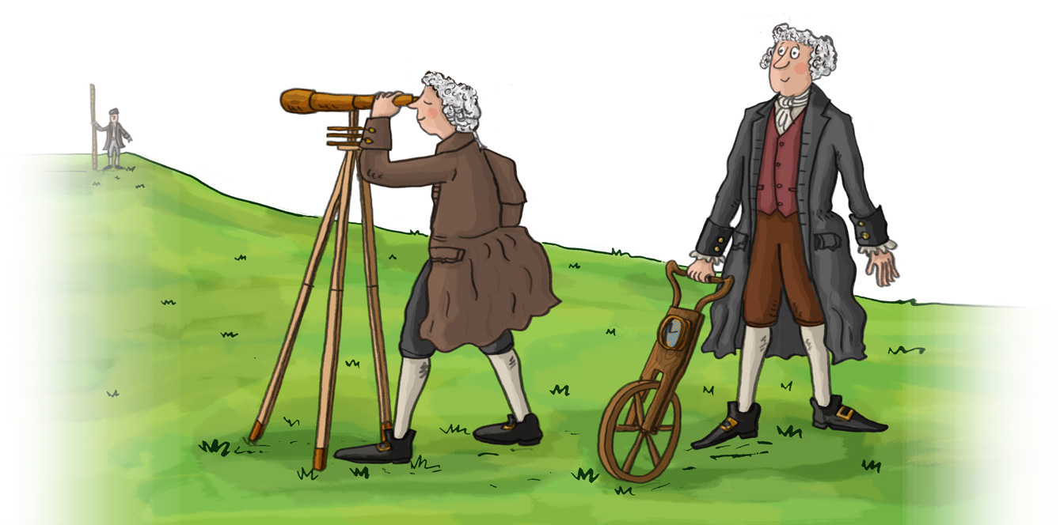
Surveyor’s Task
You are a going to be a surveyor, planning the route of the canal between Chirk and Llantysilio.
You will need to investigate the landscape to find the best route for the canal.
You will do this using online maps.

Slide 8

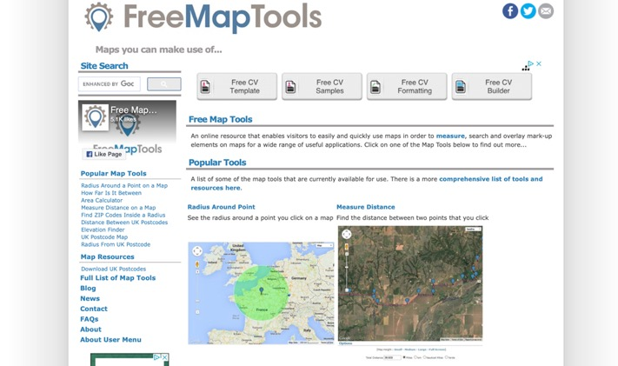
Investigation and Reconnaissance
First you need to find the start and end points for the canal.
The Llangollen Canal starts at Chirk and ends at the Horseshoe Falls at Llantysilio.
Use the online mapping freemaptools.com to find Chirk and Llantysilio.
Click on the Measure Distance tool.

Slide 9
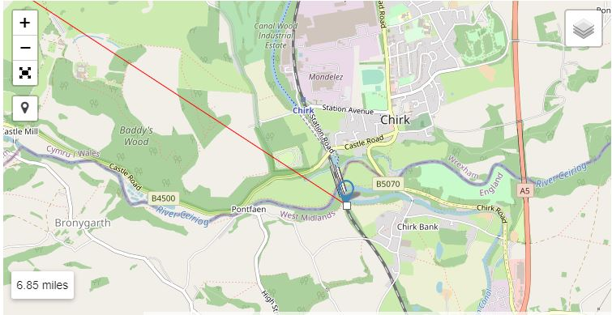
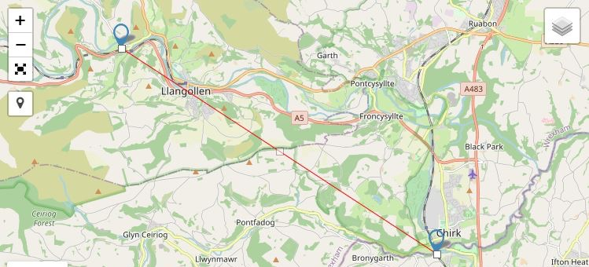

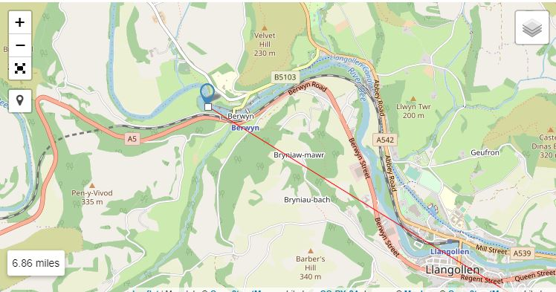

Investigation and Reconnaissance
Type the name of the towns into the search tool to find them.
Click on Chirk and then Llantysilio, the tool will draw a straight line to measure the distance between them. (For Llantysilio you will have to zoom in to Berwyn and the Horseshoe Falls).
You can make the map full screen using the icon on the left.

Slide 10
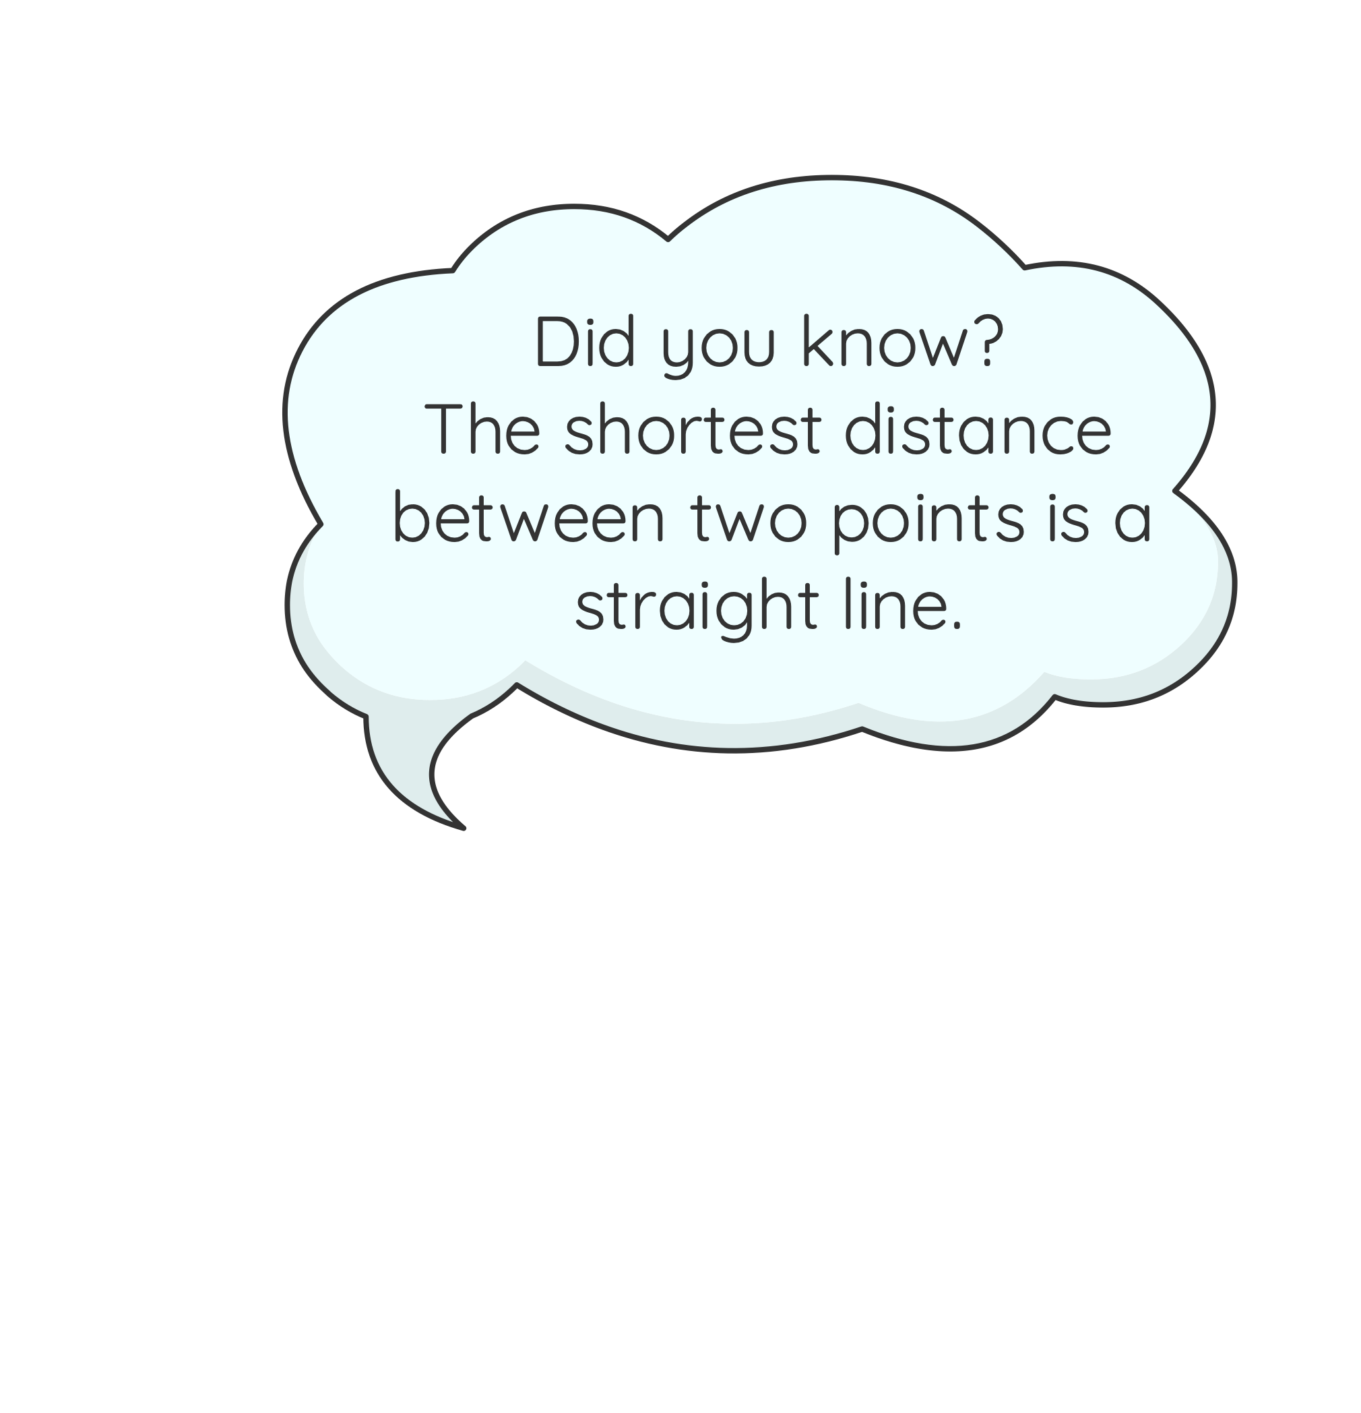
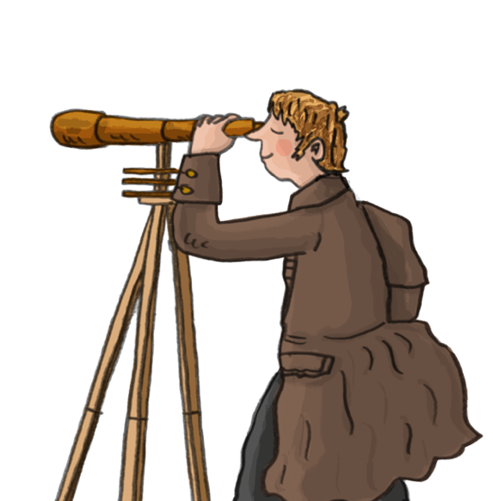
Investigation and Reconnaissance
What is the distance between Chirk and Llantysilio in a straight line?

Slide 11
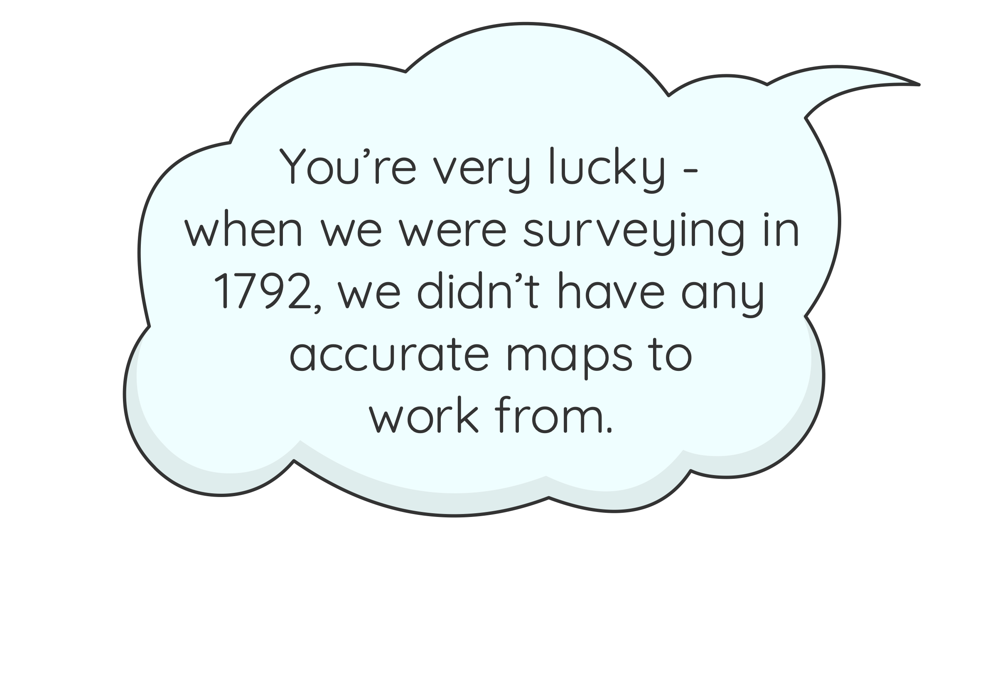
Landscape Detectives
We want you to imagine you are helping Duncombe and Turner to plan a route for the canal through the landscape between Chirk and Llantysilio.

Slide 12
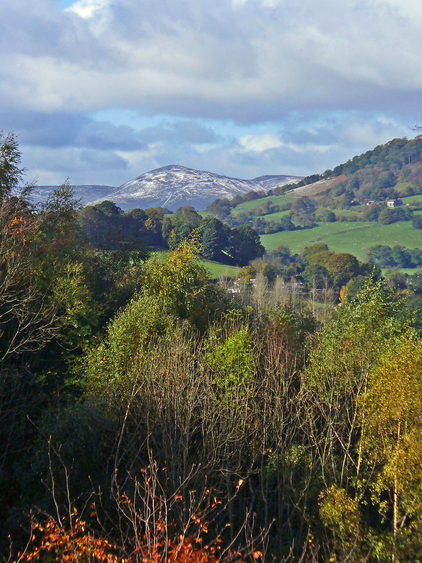
Landscape Detectives
Your modern map shows many of the same features and obstacles that Duncombe and Turner would have seen in the landscape.
The photographs show some features to consider.
Use the map to identify potential obstacles along the route and help find the best route for the canal.
Your map also shows the actual route of the canal and other newer features like modern roads and railways but we want you to ignore these for now.
© John Clift Creative Comms BY-NC 2.0

Slide 13
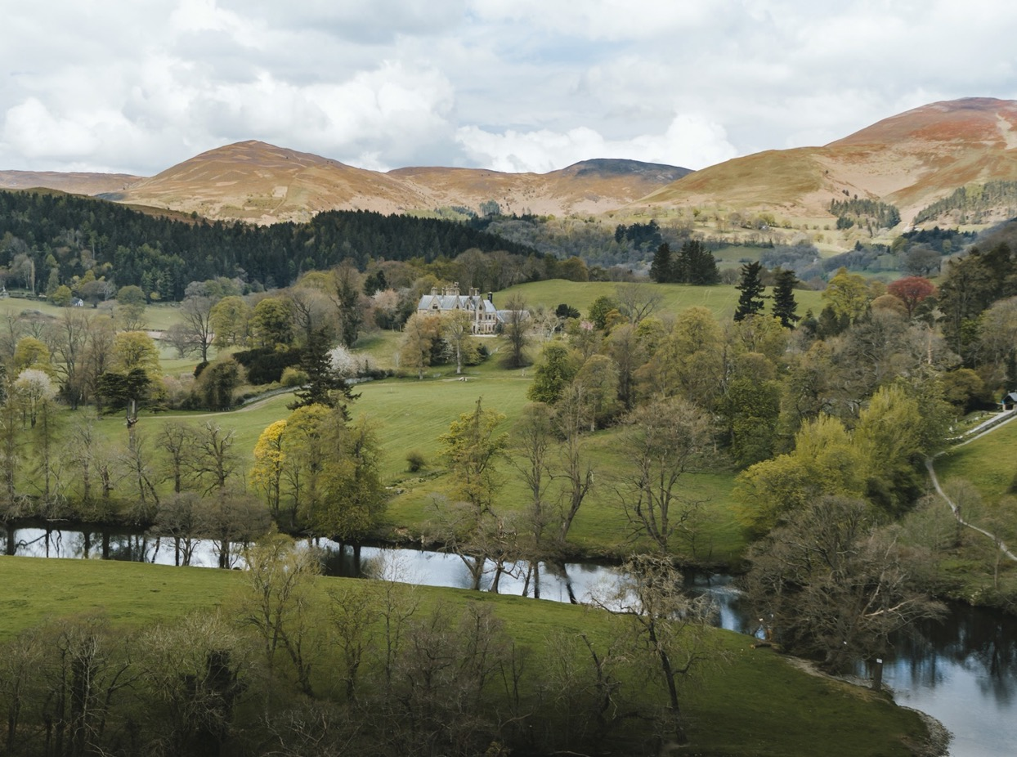
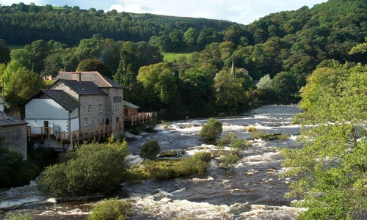
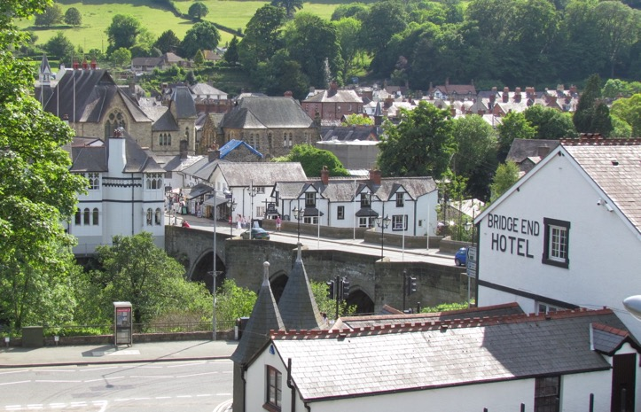
Landscape Detectives: Features to Consider
© The Corn Mill
© Heather Williams
© WCBC
© John Clift Creative Comms BY-NC 2.0

Slide 14
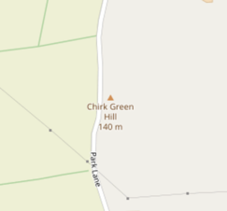
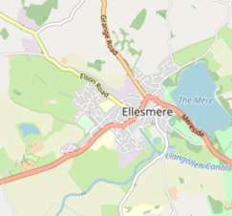
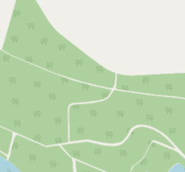
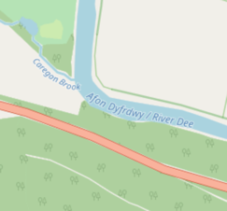
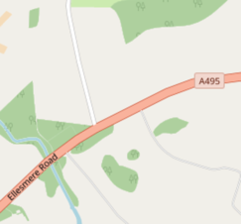
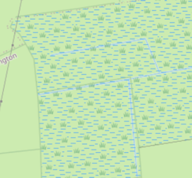
Landscape Detectives: Features to Consider
Identify natural and man-made features on the map along the straight route you have made between Llantysilio and Chirk.
Can you find any of these along the route?
Hills
Towns
Woodlands
Rivers
Roads
Marsh Areas
Can you identify any other obstacles?
© John Clift Creative Comms BY-NC 2.0

Slide 15

Obstacles and Solutions
What problems could these features cause to your canal building project and what solutions can you design to avoid or cross them?
Obstacle | Number | Physical (tick) | Human (tick) | Solutions (there may be more than one)

Slide 16
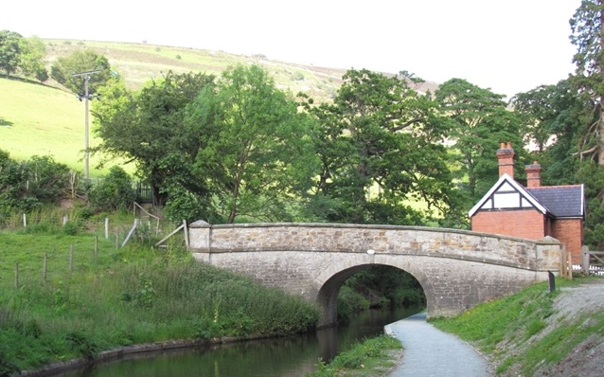
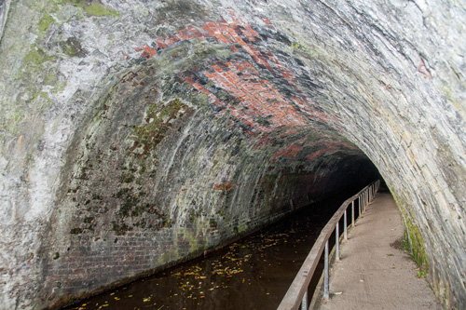
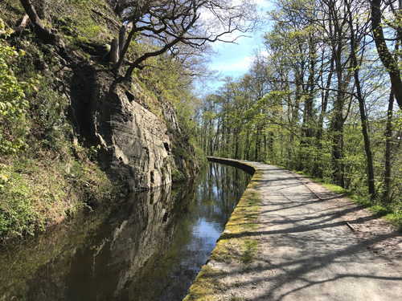
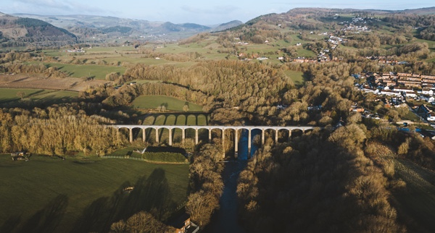
Solutions
Here are some examples to get you started but you can let your imagination run wild and think of different ways to avoid the obstacles.
Bridges
Tunnels
© Heather Williams
Aqueduct
Cutting through rock
© WCBC

Slide 17
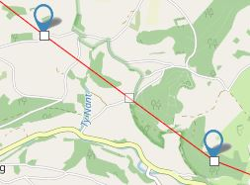
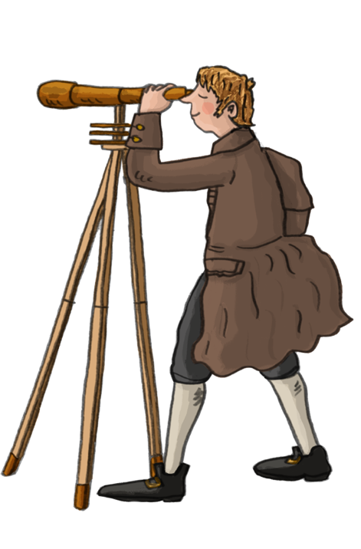
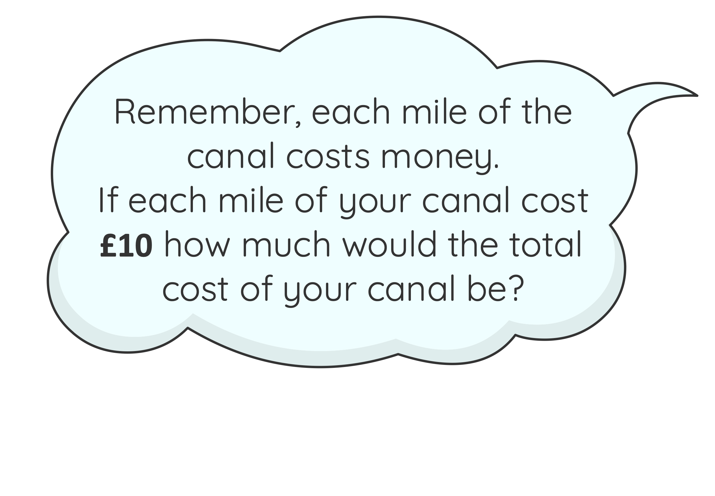
Super Surveyors
If you are confident with the map tools then try this activity.
You have identified the problems and which features need to be avoided. Now to plan your route like Duncombe and Turner.
Go back to the map. On the route line you have drawn there are small white squares that you can click to drag the line to avoid the obstacles in the landscape.
How long is your route?
Click and hold to drag the squares to where you want the route to go. As you release the square, more squares are created so you can make the route how you want it. Drag the route to make it the best and safest route for your canal.

Slide 18
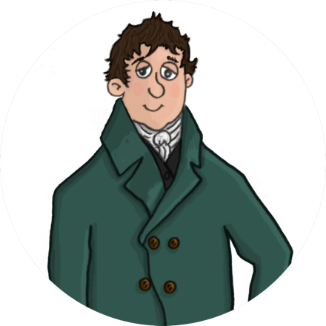




Reporting back to Thomas Telford
Thomas Telford
Draw a map of your chosen canal route to show to Thomas Telford.
Include any features you have avoided, as well as the solutions you created.
Compare your route with the actual route the canal takes.
Do you agree with this route? Could they have taken a different route?
Compare your route with your classmates.
How does it differ?

Slide 19
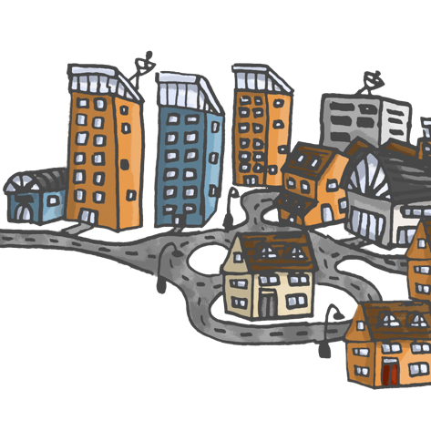
What would it be like building a canal today?
See if you can find out about any new or recent construction projects like new roads or buildings being built near you today.
Think about how this new construction
will affect you and your school and family.
How will it impact your local area?
Will it be positive or negative on your community?
Will it create more jobs?
How will it affect the environment?

