Slide 1
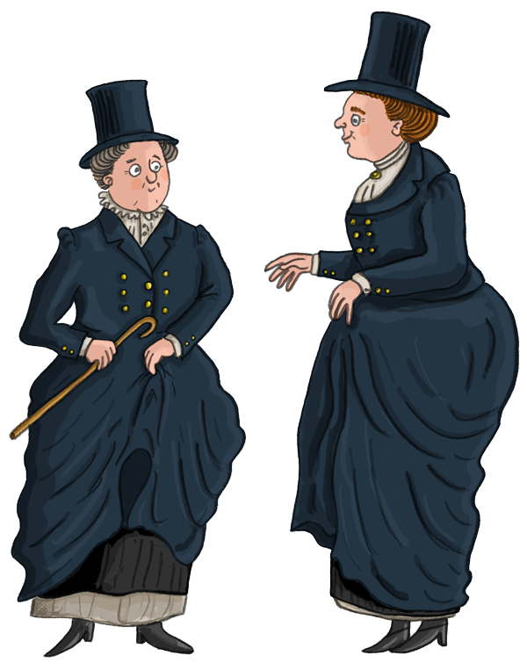
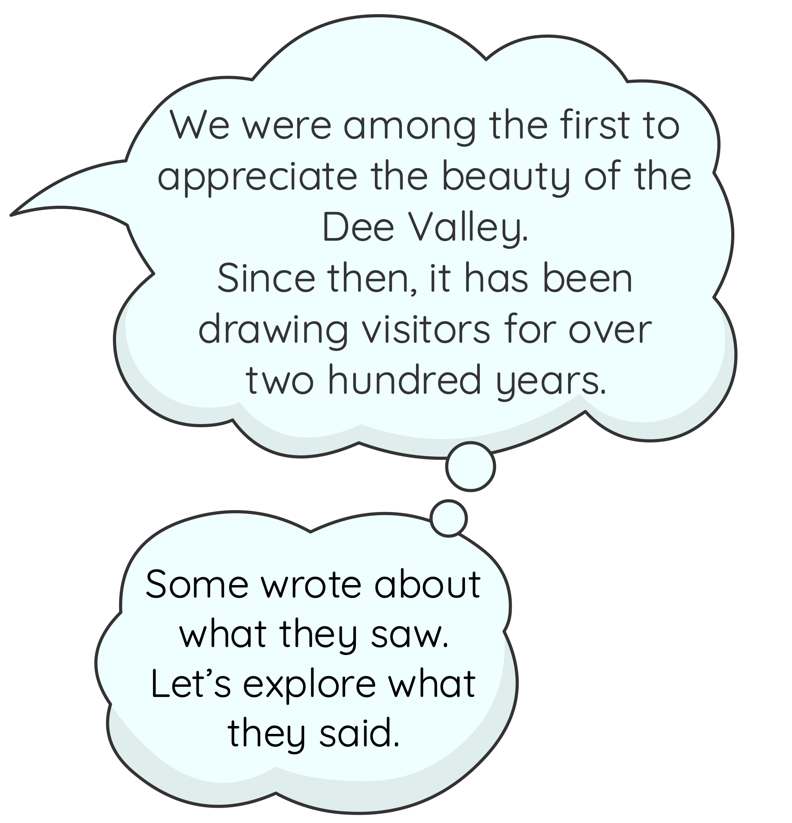
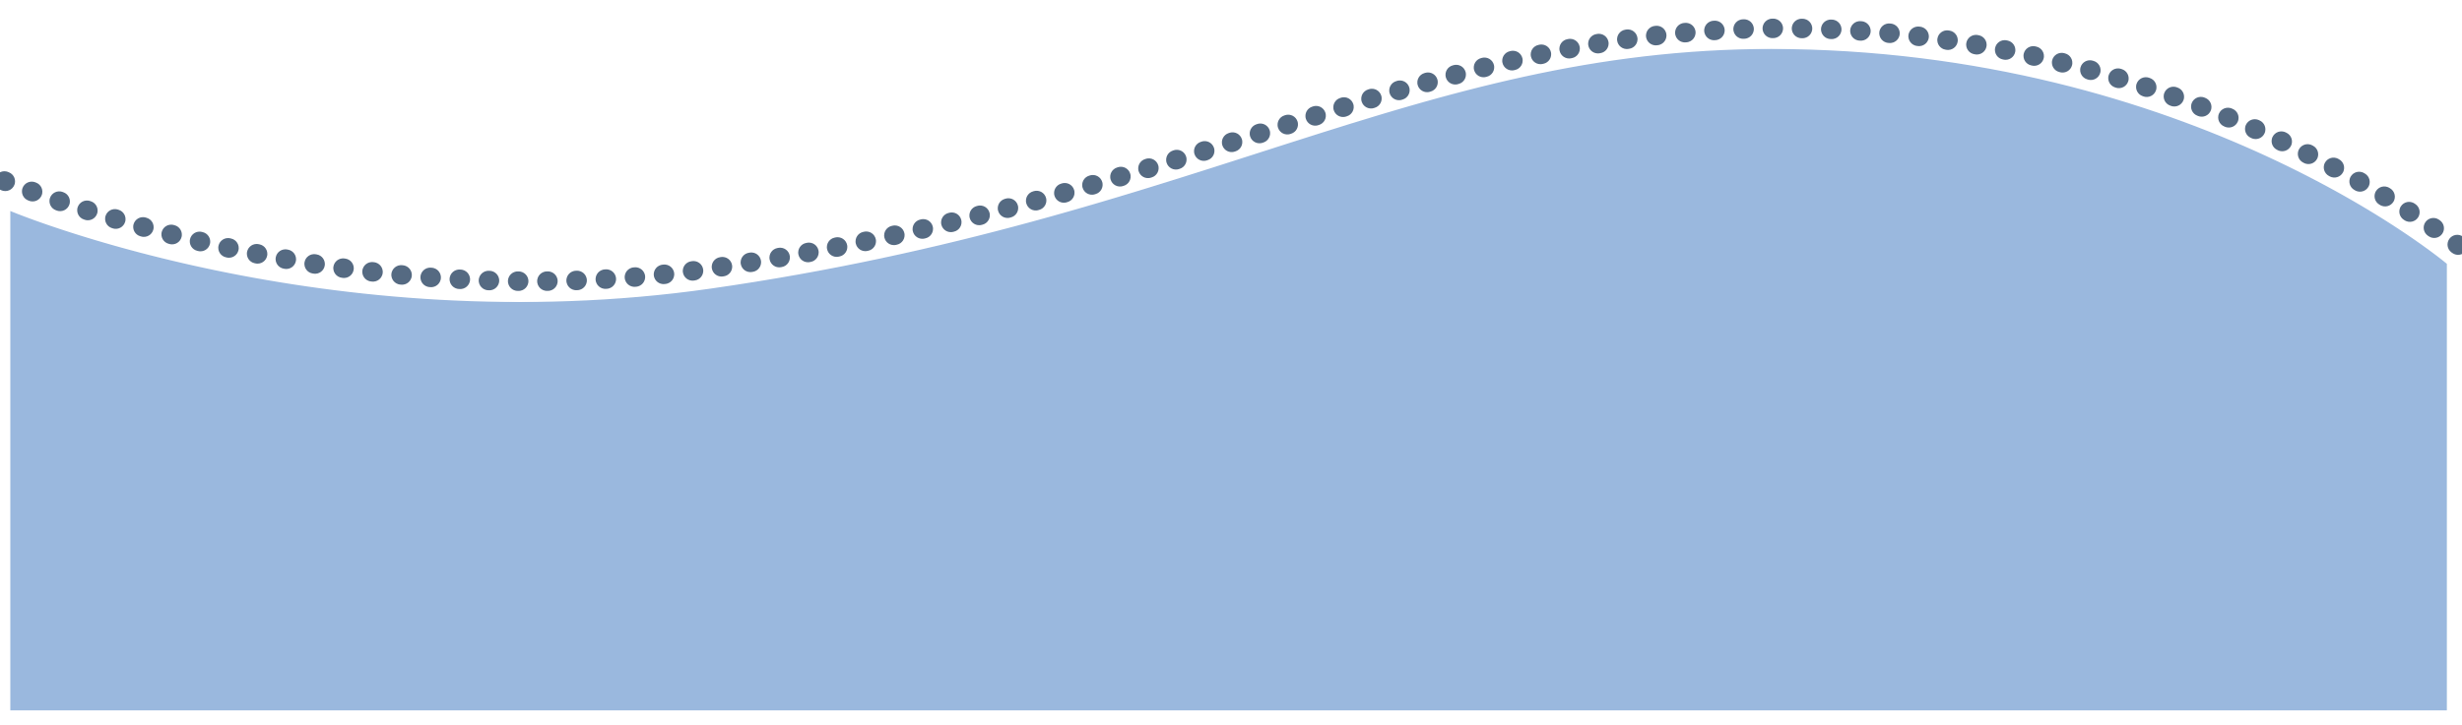
Revealing the Dee Valley
Ladies of Llangollen
www.pontcysyllte-aqueduct.co.uk

Slide 2

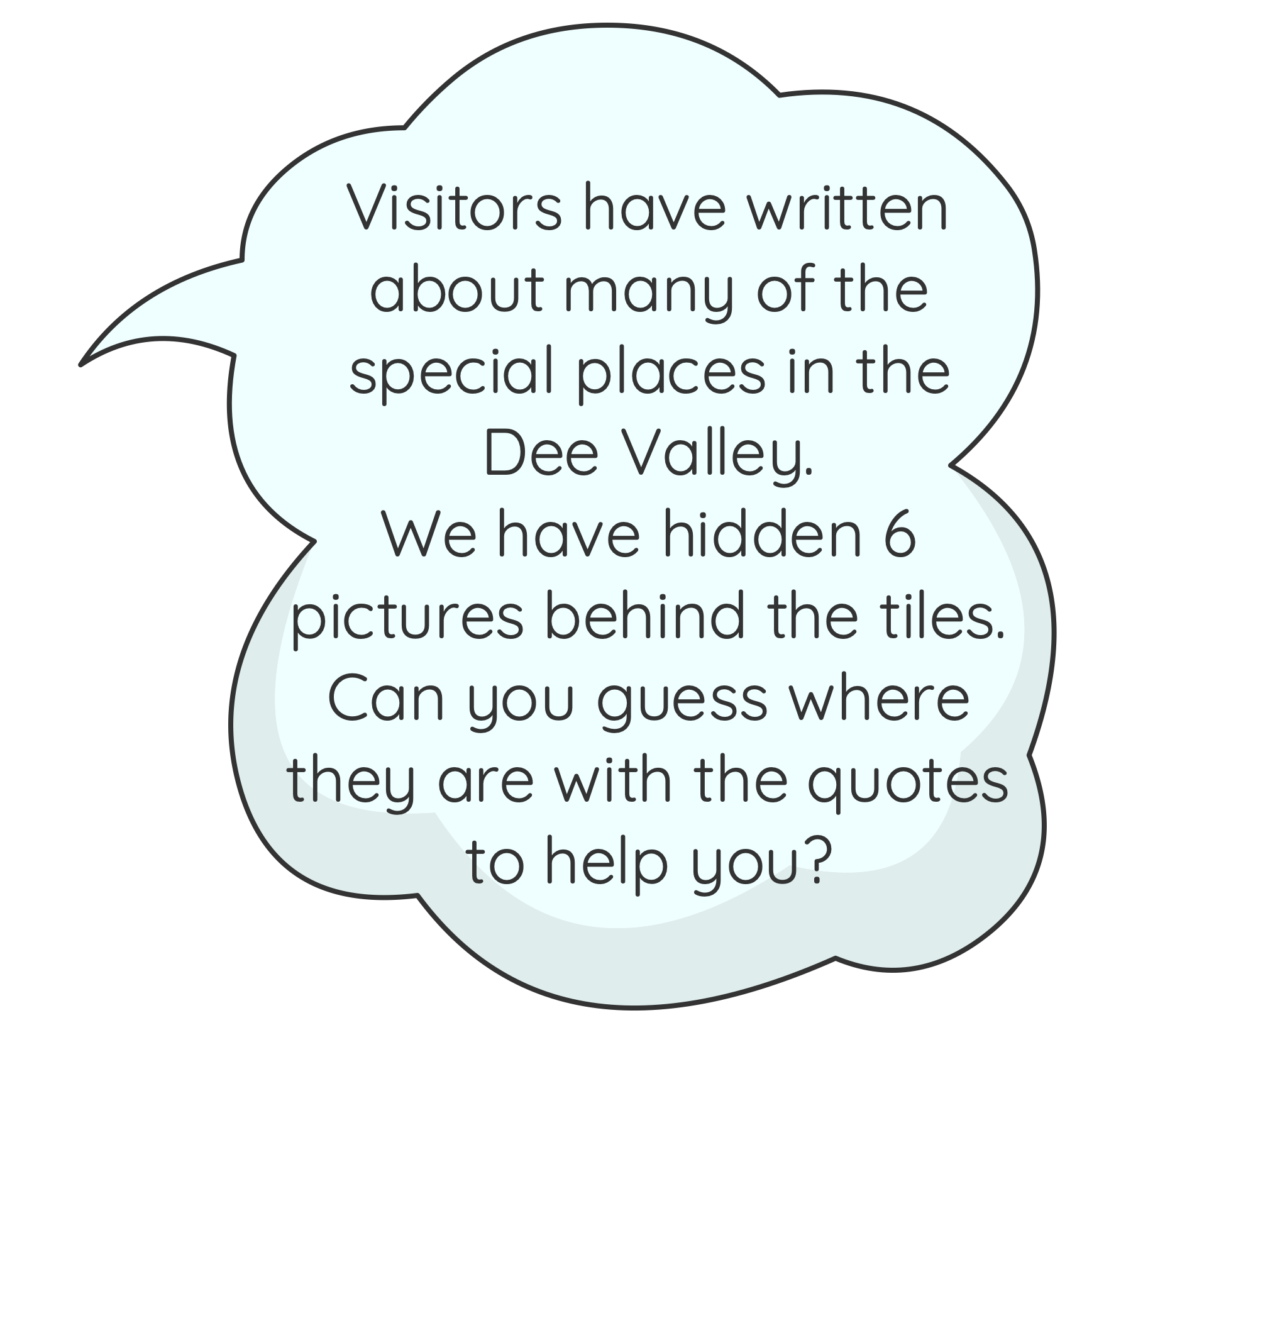

Revealing the Dee Valley
Instructions
Read the quote and guess which special place it is talking about.
Click on each tile to reveal a section.
After each section has been revealed try and guess what the special place might be.
Once you can see the whole image, guess where the special place is. Think about what makes this place special.

Slide 3


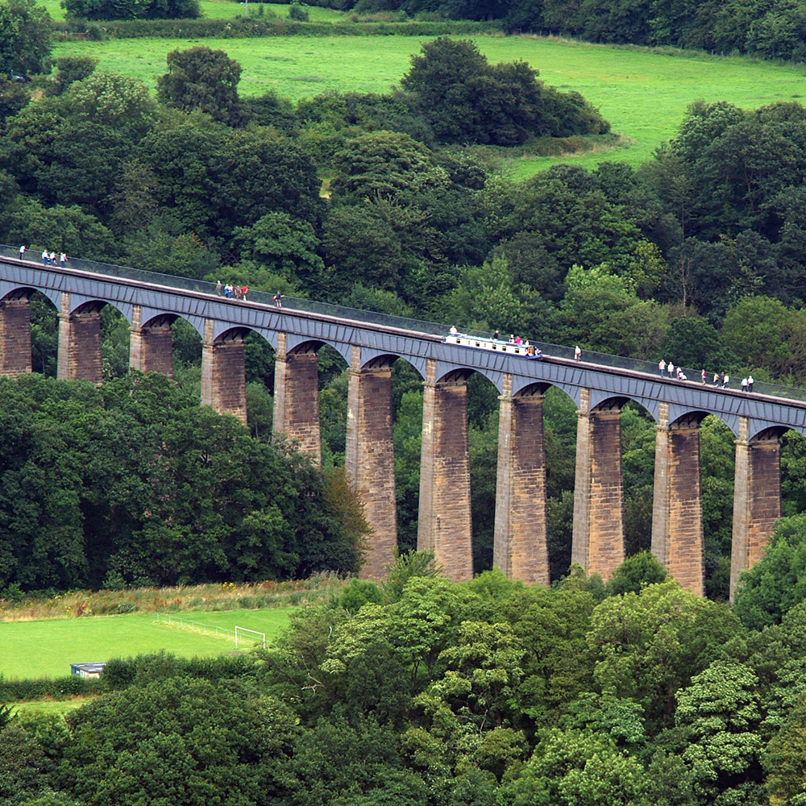
Dee Valley Mystery Number One
This…reflects great honour to the undertakers of so admirable, as well as valuable enterprise…It is forming over the most beautiful and romantic part of the river Dee; a bridge likewise, not far from this spot, adds considerably to the beauty of the scene.
Wood, water, and Hoping hills, all combine to render this vale interesting…
Anonymous, 1798
Click here
to see the answer…
© WCBC

Slide 4
Pontcysyllte Aqueduct
Next
mystery:
© WCBC

Slide 5
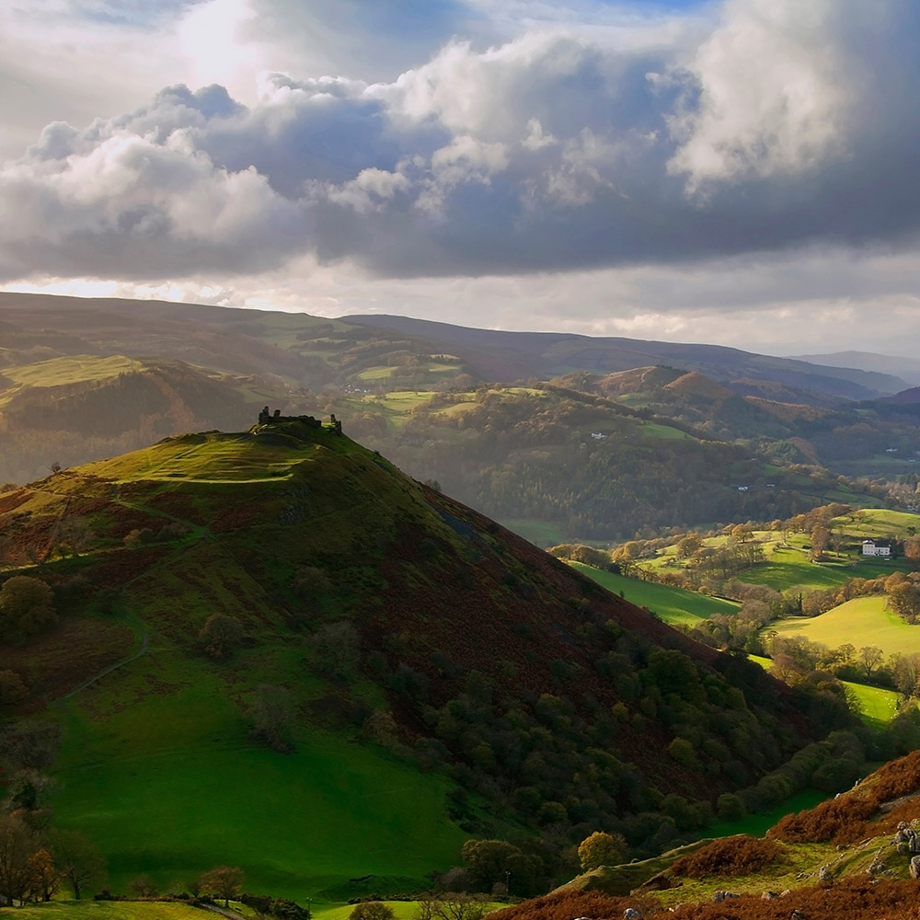
Dee Valley Mystery Number Two
…I knew nothing of but from description; and where is the pen or the pencil that can do justice to the beauty or the grandeur of the scenery? (It)…stands unrivalled; broken into the most enchanting intricacies, finely wooded, with the Dee winding its “wizard stream” through it, and rising from its banks the lofty conical hill…crowned with its aerial castle partly hid in clouds…
Richard Fenton , 1808
Click here
to see the answer…
© Clwydian Range and Dee Valley AONB

Slide 6
Vale of Llangollen and Castell Dinas Brân
Next
mystery:
© Clwydian Range and Dee Valley AONB

Slide 7
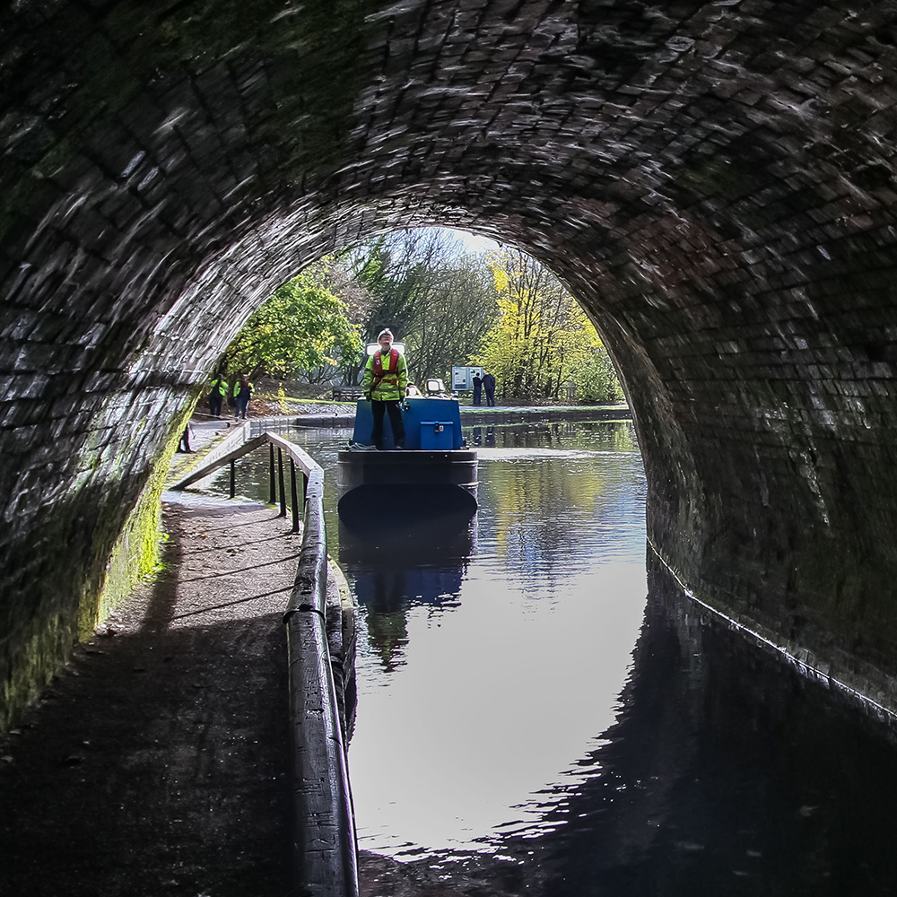

Dee Valley Mystery Number Three
[We] agreed to take advantage of some barges that were approaching and passed through in one of them…The effect on receding from the light at the entrance and approaching to it at the exit…was very curious and it was increased by an immense number of small stalactites which hung from the roof and which being white and projecting were last visible as we went in and first illuminated as we approached the opposite end…
Dafydd Tomas, 1819
Click here
to see the answer…
© Canal & River Trust

Slide 8
Chirk Tunnel
Next
mystery:
© Canal & River Trust

Slide 9
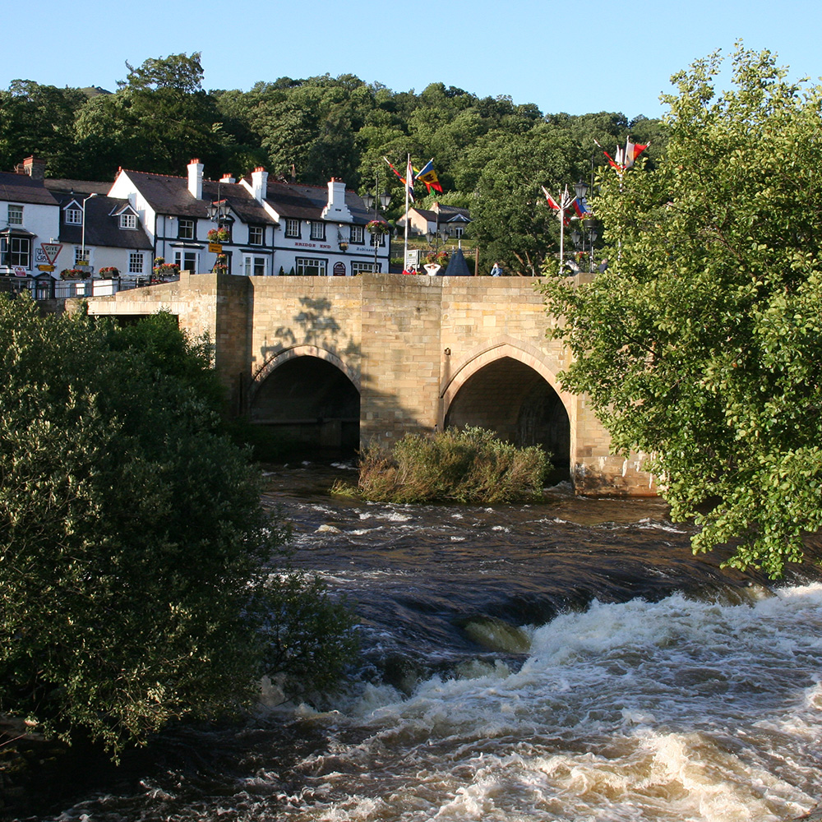
Dee Valley Mystery Number Four
I confess I was a little disappointed, for instead of the most quiet, lovely spot that I imagined nature could have made, here was all the noise, smoke, and bustling appearance of the Dudley district, great quantities of coal and iron are taken from the Berwyn mountains which rise to the skys on either side...
William Maymott, 1840
Click here
to see the answer…
© Carl Rogers

Slide 10
Llangollen
Next
mystery:
© Carl Rogers

Slide 11
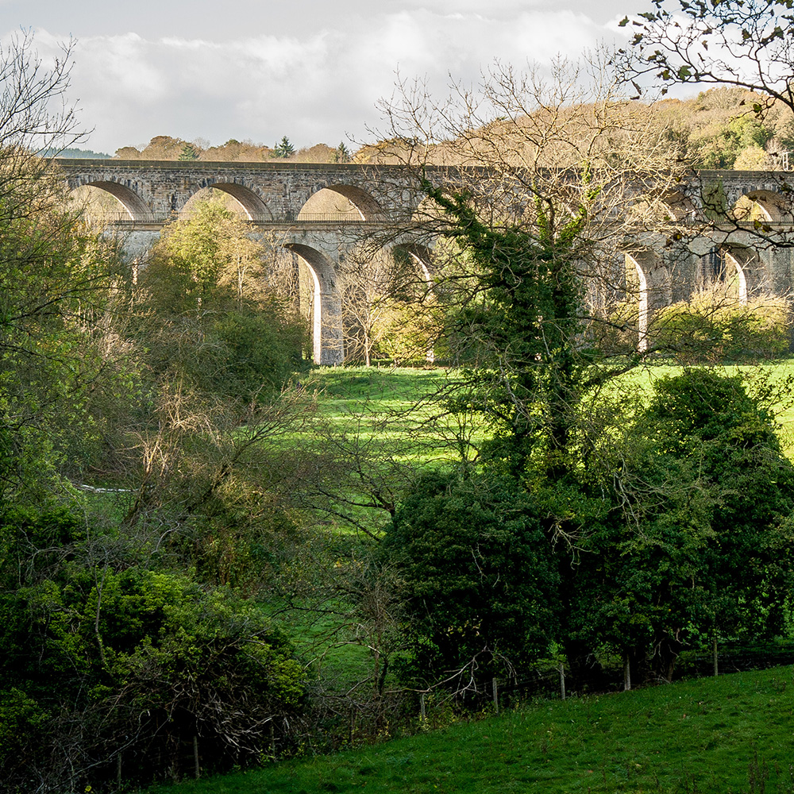
Dee Valley Mystery Number Five
After reaching the road we continued our course towards the pretty village…which is very neat and clean, some of the cottages built in the Swiss style. The fine old church stands on the edge of a vale well wooded with the river Ceiriog running at the opposite side. Another aqueduct crosses this vale in the service of the Ellesmere canal and very much spoils the effect.
Miss Dovaston, 1846
Click here
to see the answer…
© Canal & River Trust

Slide 12
Chirk
Next
mystery:
© Canal & River Trust

Slide 13
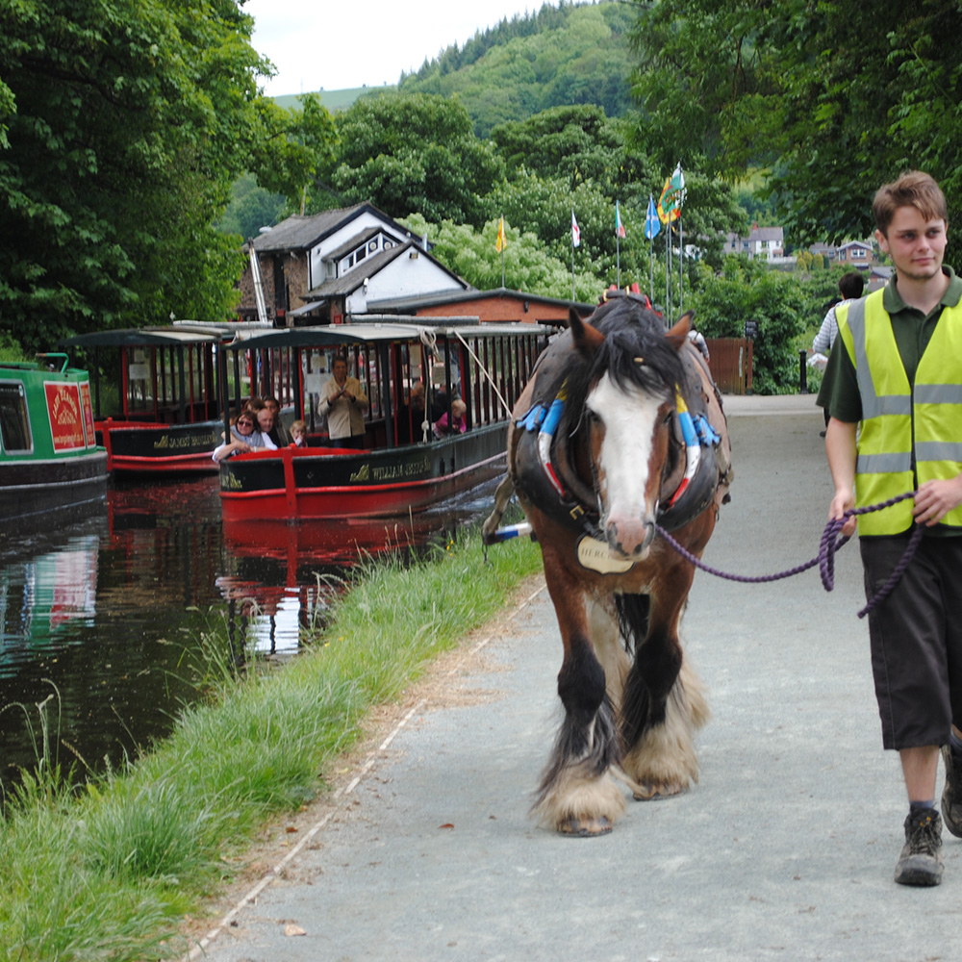
Dee Valley Mystery Number Six
Booked on a whim after seeing reviews and pictures. Well worth the money. Lovely views and a very relaxed atmosphere. The horse walked along the towpath with no cares in the world. The seating was very relaxed and spread out due to the current COVID restrictions. Would definitely recommend for all ages although toddlers might get a bit bored.
Anon, 2020
Click here
to see the answer…
© Jo Danson

Slide 14
Llangollen Wharf
Next
mystery:
© Jo Danson

Slide 15
Revealing the Dee Valley
Well done!
You have discovered six wonderful places in the Dee Valley.
Find out more about travel and tourism in the Dee Valley on our website.
www.pontcysyllte-aqueduct.co.uk

