Slide 1

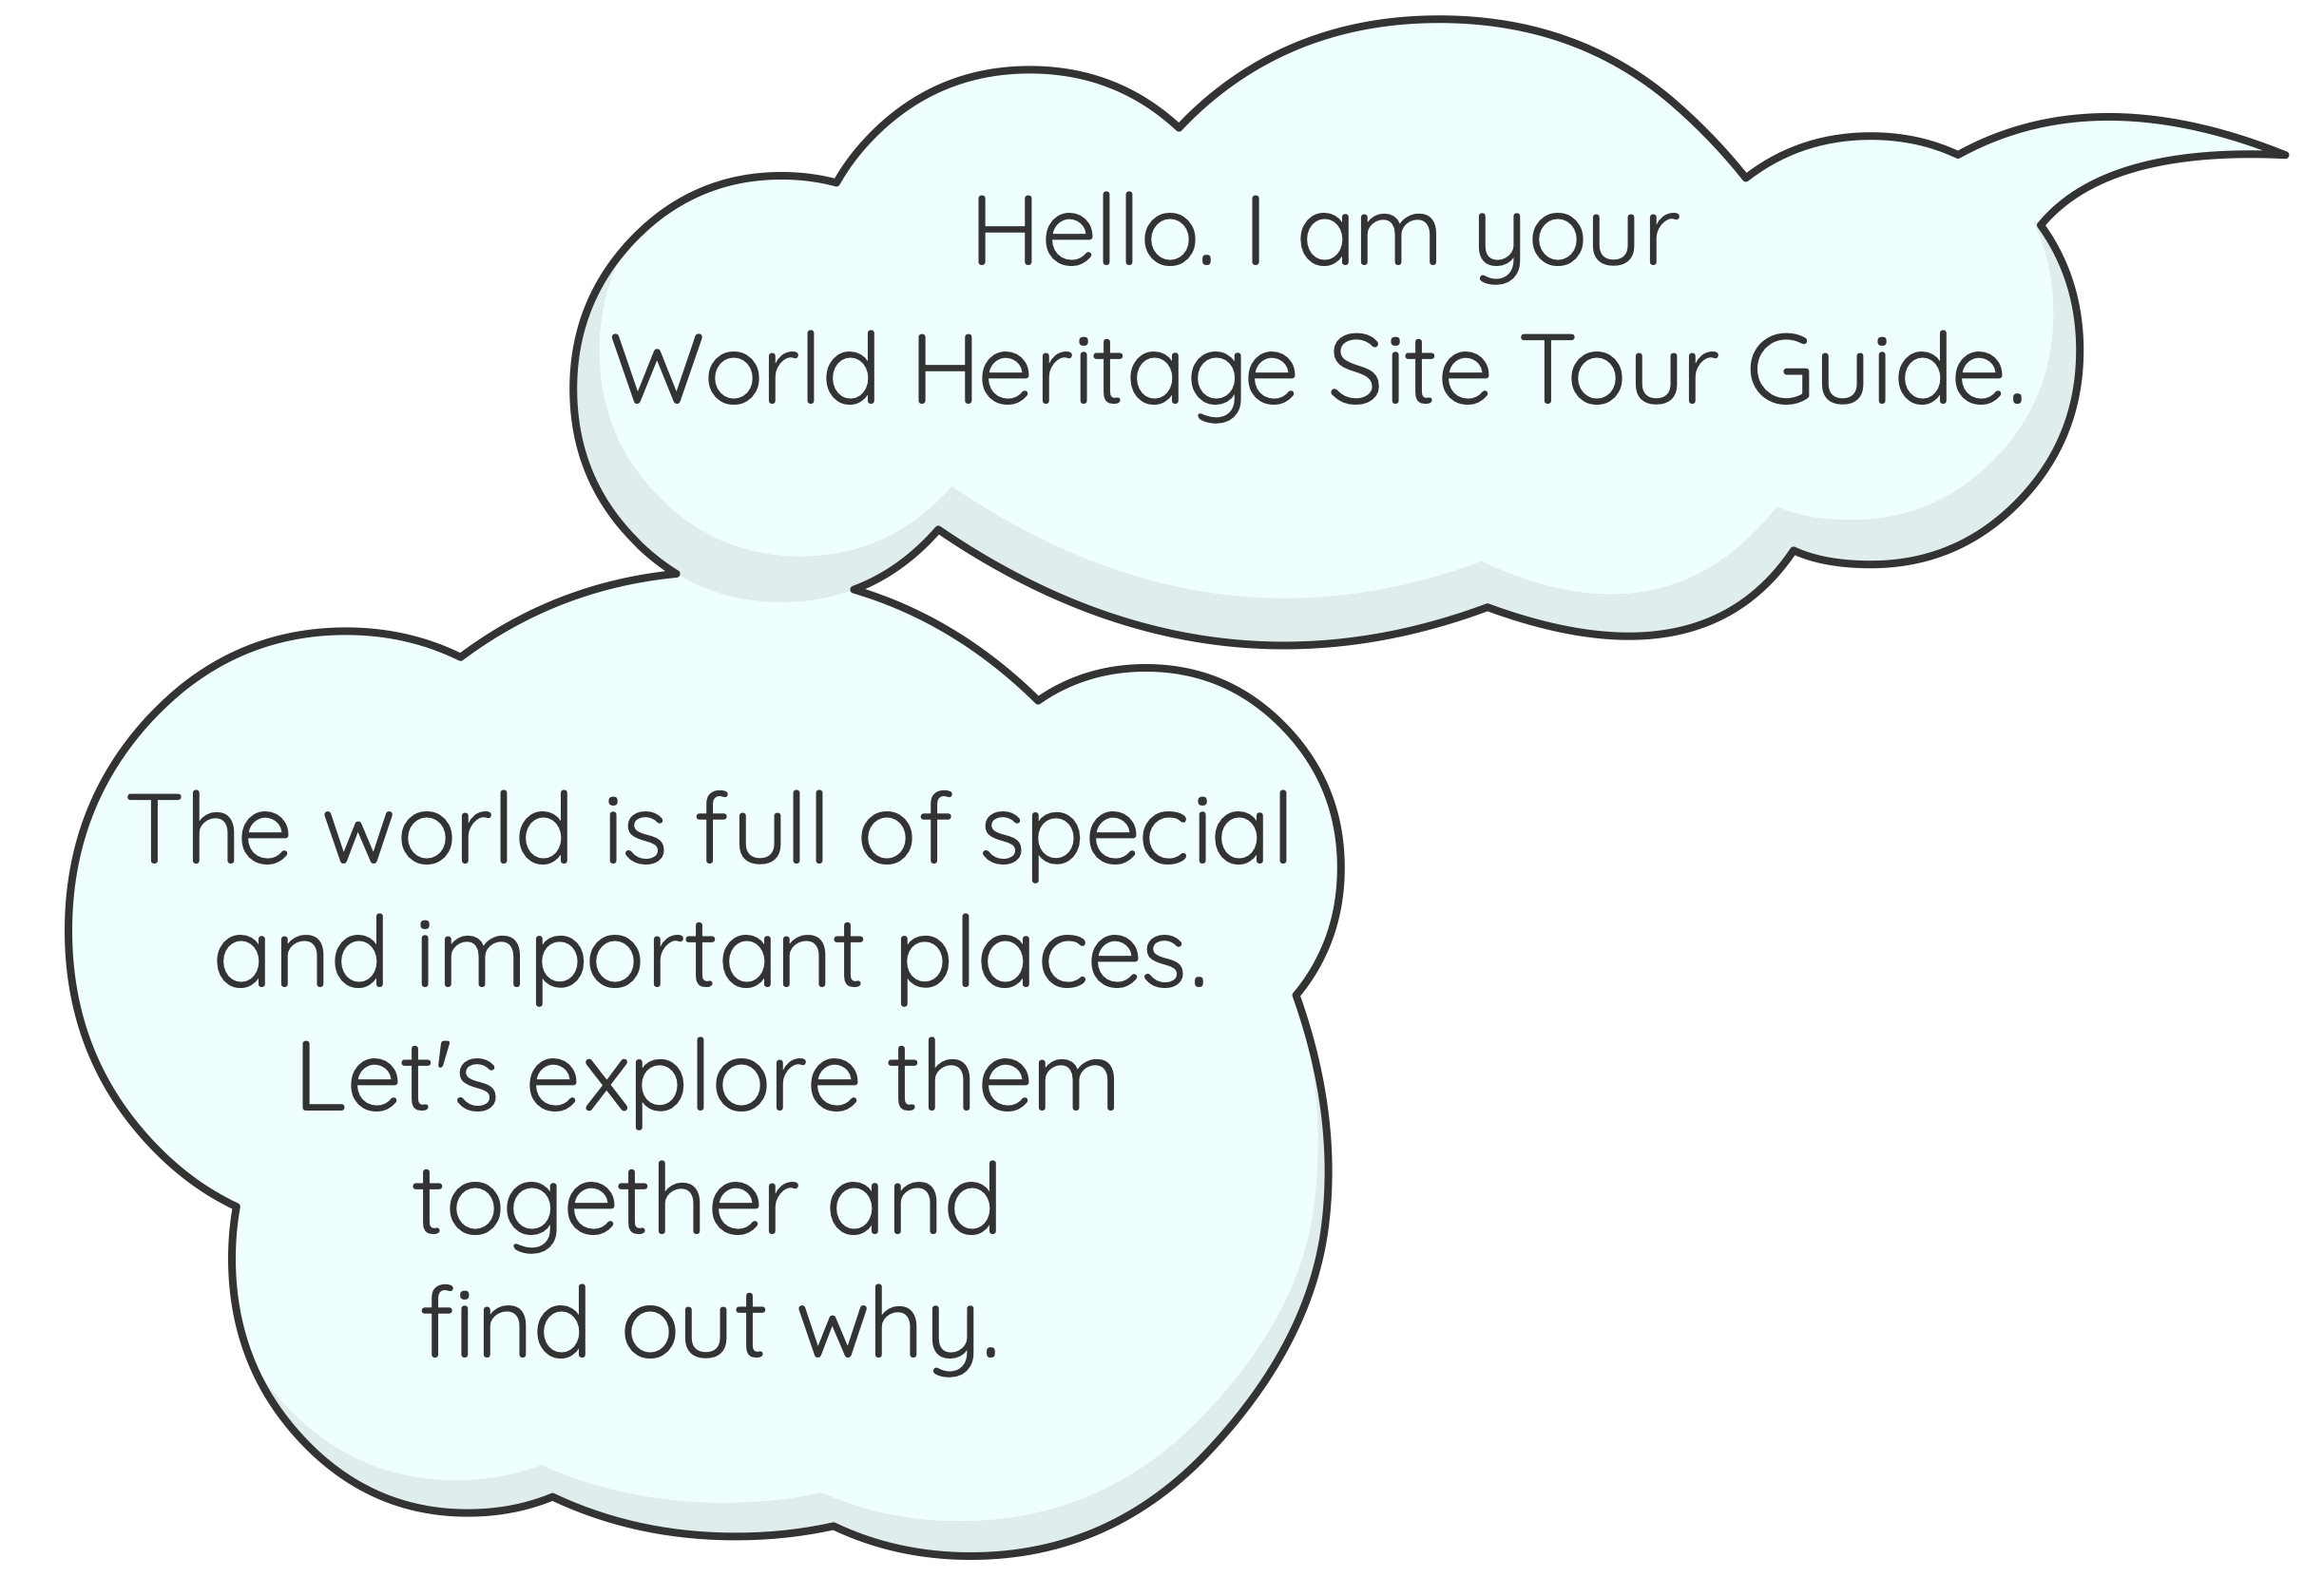


Discovering World Heritage Sites
www.pontcysyllte-aqueduct.co.uk

Slide 2

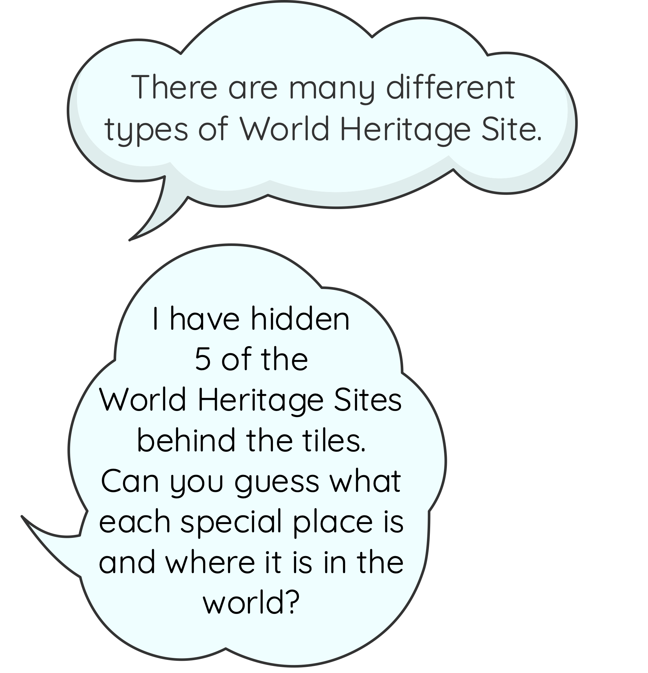


Mystery World Heritage Sites
Instructions
Click on each tile to reveal a section …
After each section has been revealed try and guess what the site might be.
Once you can see the whole image, guess where the site might be. Think about what makes this site special.

Slide 3


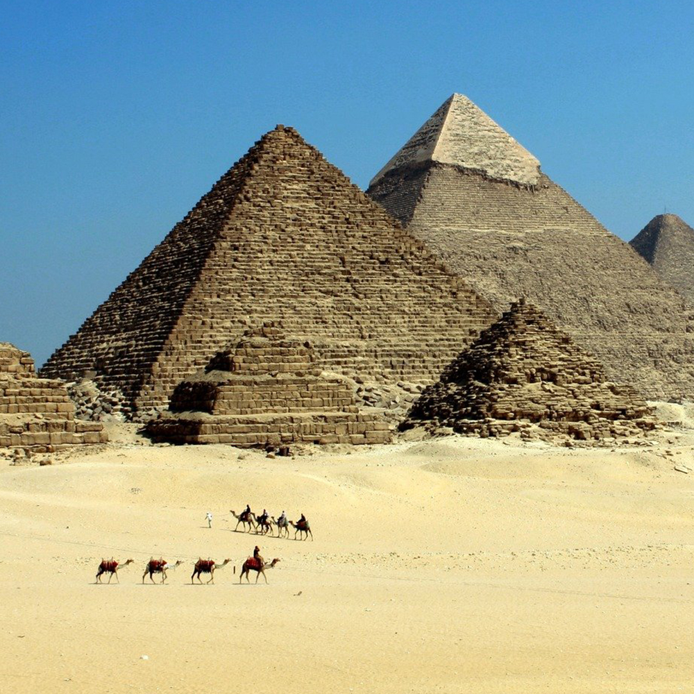
Mystery Site One
Click the squares to reveal the picture
Click here
to see the answer…

Slide 4


Pyramids of Giza
Where is it?
…Egypt
Next
mystery:

Slide 5
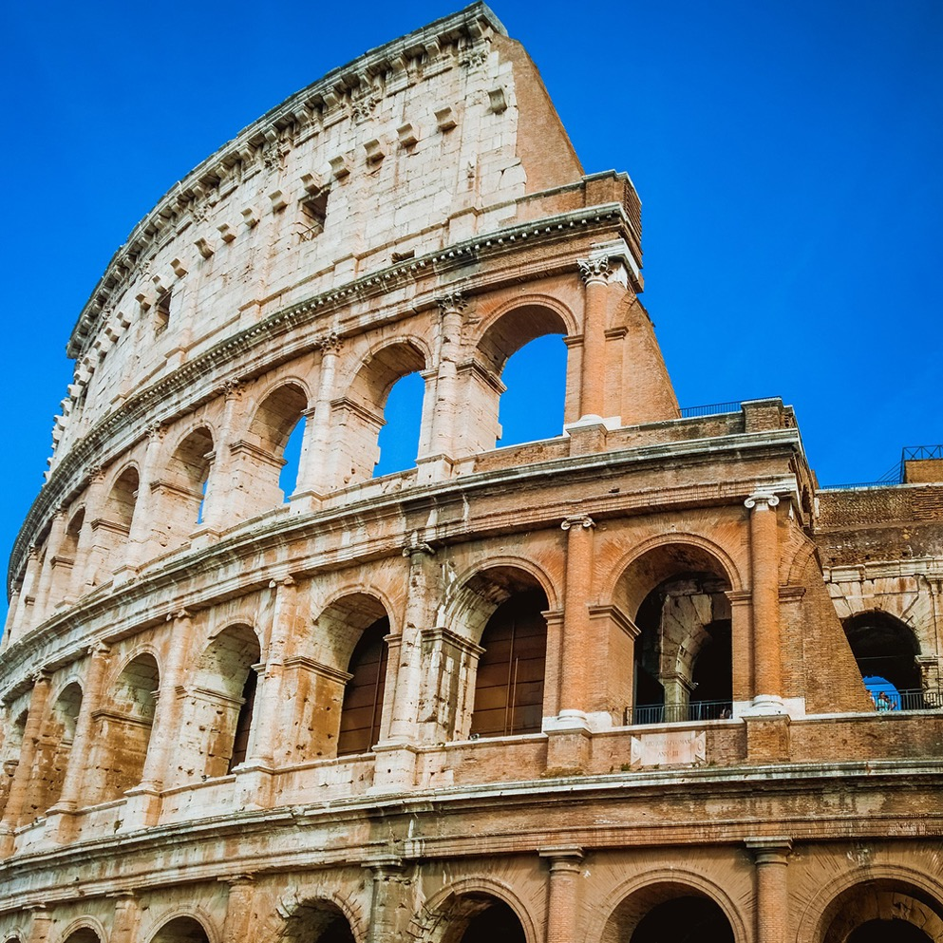
Mystery Site Two
Click the squares to reveal the picture
Click here
to see the answer…

Slide 6
Historic Rome
Where is it?
…Italy
Next
mystery:

Slide 7
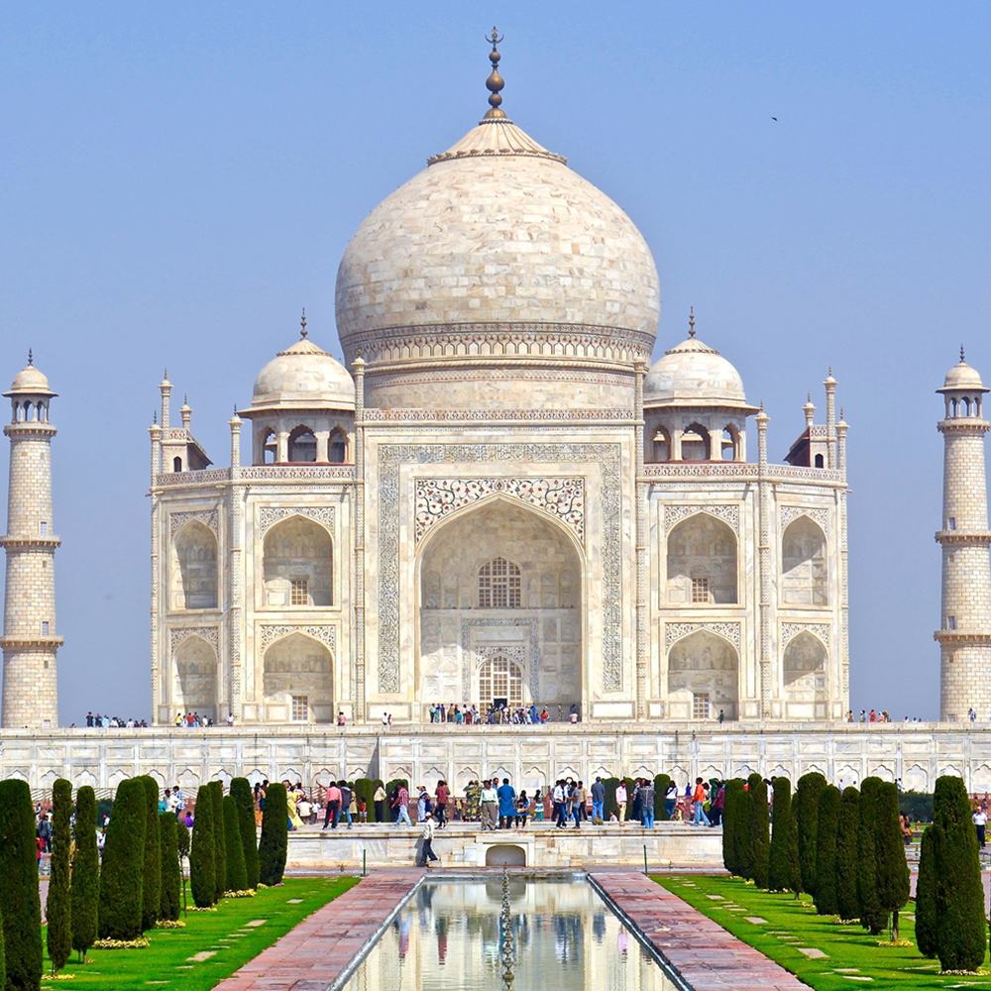
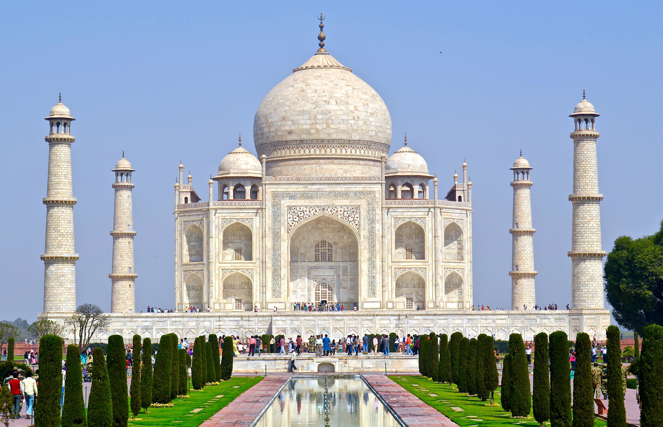
Mystery Site Three
Click the squares to reveal the picture
Click here
to see the answer…

Slide 8
Taj Mahal
Where is it?
…India
Next
mystery:

Slide 9
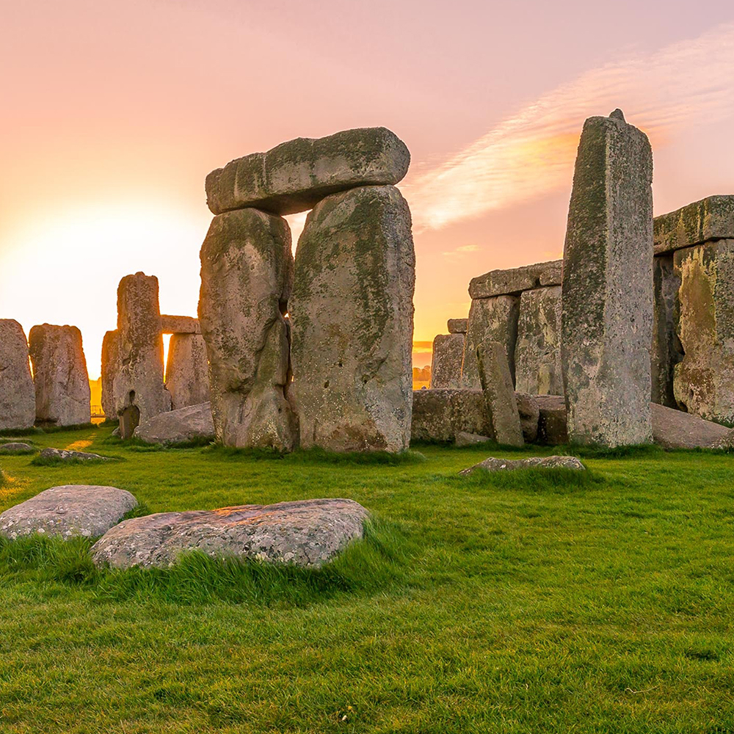
Mystery Site Four
Click the squares to reveal the picture
Click here
to see the answer…

Slide 10
Stonehenge
Where is it?
…England
Next
mystery:

Slide 11
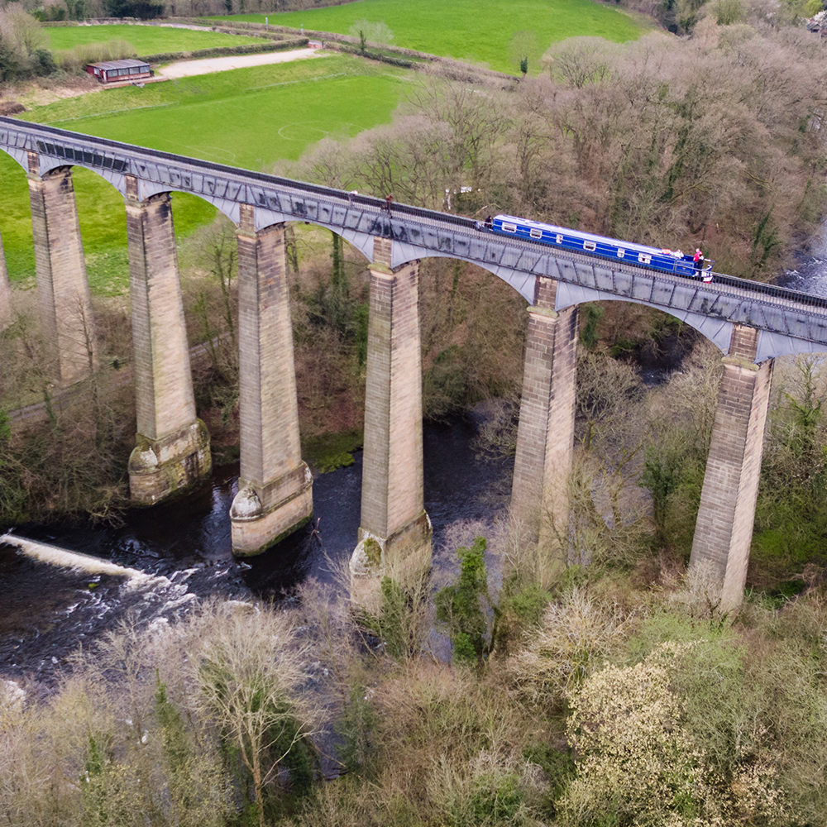
Mystery Site Five
Click the squares to reveal the picture
Click here
to see the answer…

Slide 12
Pontcysyllte
Where is it?
…Wales

Slide 13

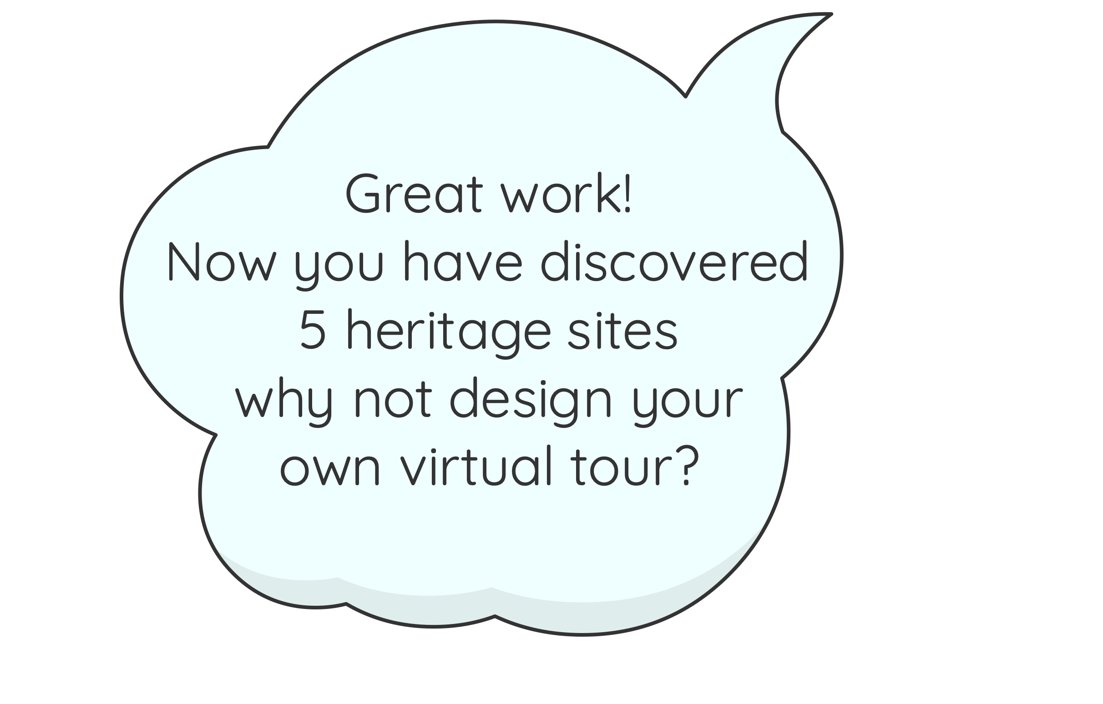
Discovering World Heritage Sites
Tour Information:
Use the ‘Tour Guide Activity’ notes on our website
www.pontcysyllte-aqueduct.co.uk

